Slide 1
Prevention of Recurrent Stroke: An Evidence-Based Approach
Korinne Novak APRN, CNP
Michelle Ullery DNP, APRN, CNP
Uche Amajuoyi APRN, CNP
Mark Ringo DNP, APRN, CNP
April 15th, 2016

Slide 2
Objectives
1. Recognize risk factors for recurrent stroke.
2. Apply current guidelines to manage risk factors for recurrent stroke in the sub-acute and primary care setting.
3. Learn how to support health-promoting behaviors among high risk groups.

Slide 3
Stroke
> 790,000 adults experience ischemic stroke each year in the United States, 185,000 are recurrent strokes
2nd most common cause of mortality and 3rd most common cause of disability
Incidence decreasing in high income countries, increasing in low income countries
Recurrent
Approximately 240,000 will experience a TIA- focal neuro symptoms lasting <24 hours without imaging evidence of infarction.
TIA increases risk for future stroke
Annual risk for future stroke after initial is 3-4%.
Notes:
This rate has improved related to antiplatelet therapy, strategies for HTN management, A-fib as well as hyperlipidemiaRisk is affected by characteristics such as type of event, age, comorbidities and adherence to therapy

Slide 8
Ischemic Stroke- 80% of all strokes
Thrombosis
    Large Vessel Disease including common carotids and intracranial arterial system
    Small Vessel Disease- intracerebral arterial system. Distal vertebral and basilar arteries
    Atherosclerosis most common cause
Embolism
    Common risk factors Afib, valve replacement, recent MI
Hypoperfusion

Slide 9
Hemorrhagic
32% incidence globally
Intracranial hemorrhage
  HTN, trauma, drug abuse
Subarachnoid hemorrhage
  Ruptured aneurysm, vascular malformation

Slide 10
Non Modifiable Risk Factors
Age >80
Ethnicity. Black higher risk compared with white
Sex. Men higher risk than women with exception of ages 35-44 and >85
Family History

Slide 11
Modifiable Risk Factors
Smoking- doubles stroke risk. Risk disappears 2-4 years after quitting
HTN- most common stroke risk factor, severe HTn with increased rish for ICH
Diabetes- increase incidence of ischemic stroke
Hyperlipidemia
Heart disease
  A fib, valve disease, endocarditis, MI
Obesity

Slide 12
Case Study
Mr. H
68 year old Caucasian male
PMH: DM type 2, HTN, Paroxysmal A-fib, hyperlipidemia, BPH, osteoarthritis
PSH: left TKA, cataract surgery, removal of colon polyp, cardiac stent 5 years ago, cardioversion for A fib
SH: married, 3 adult children, retired bar owner, current smoker 40 pack-year history, 5-6 beers/week
Medications
Lisinopril 20 mg daily
Metoprolol 25 mg BID
ASA 81 mg
Rivaraxiban 20 mg daily
Tamsulosin 0.4 mg daily
Vitamin D 2,000 units daily
Metformin XL 2000 mg daily

Slide 13
MR. H
2:30 pm. Patient’s wife returned to home and found Mr H. lying on the floor. He had difficulty generating words and unable to lift his right arm and leg off of the floor
EMS was called and transported patient to ER
Upon arrival to ER
BP 190/110
ECG showed normal sinus rhythm
CT revealed Left MCA ischemic stroke

Slide 14
Mr. H’s Hospital Course
Patient was hospitalized due to stroke
Stable recovery course
Regained partial use of arm and leg
Blood pressure optimized and discharged on additional antihypertensives
Transferred to acute inpatient rehabilitation x 3 weeks prior to discharge home with his wife
Upon discharge, able to ambulate with cane and assistance

Slide 15
Current Guidelines
AHA/ASA 2014 Prevention of Stroke
ADA 2016 Diabetes
ACC/AHA 2013 Dyslipidemia
CDC 2014 Immunization

Slide 16
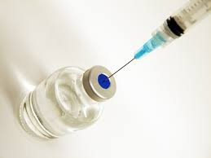
Primary Prevention
Immunizations
Annual influenza
Tdap/Td
Varicella
Zoster
MMR
Pneumococcal 13
Pneumococcal 23
(CDC, 2016)

Slide 17
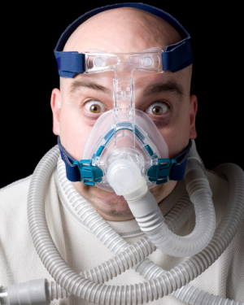
Secondary Prevention
Screen sleep apnea
Depression
Atrial fibrillation?
(ACA/ASA, 2014)

Slide 18
Tertiary Prevention
Dependent on the underlying condition(s),
know the …
Numbers
Medications
Lifestyle recommendations

Slide 19
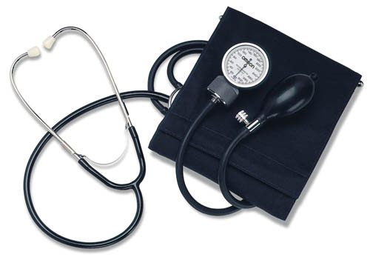
Know the Numbers
Blood pressure
Hemoglobin A1C
Body mass index

Slide 20
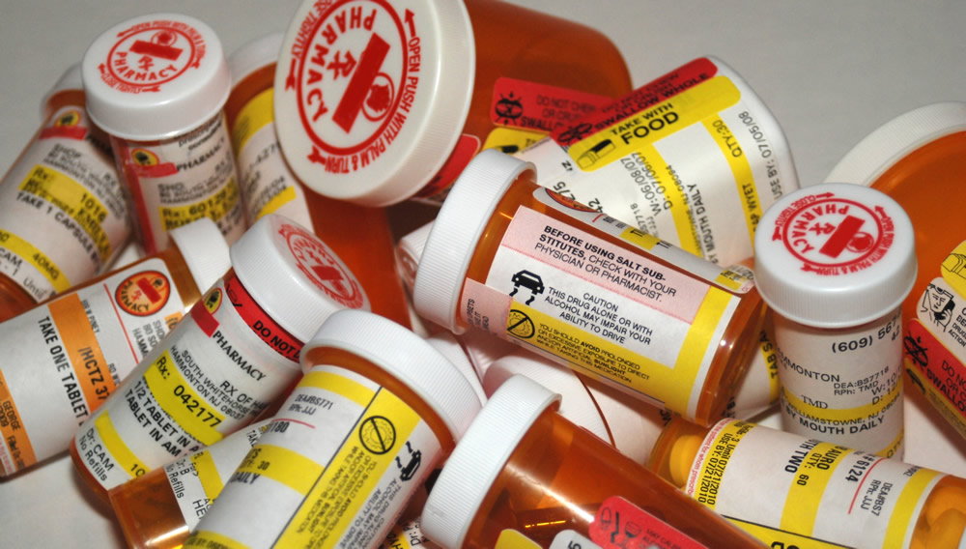
Know the Medications
High potency statins
(AHA/ACC, 2013)
Antiplatelet agents
Warfarin
Novel anticoagulants
(AHA, ASA, 2014)

Slide 21
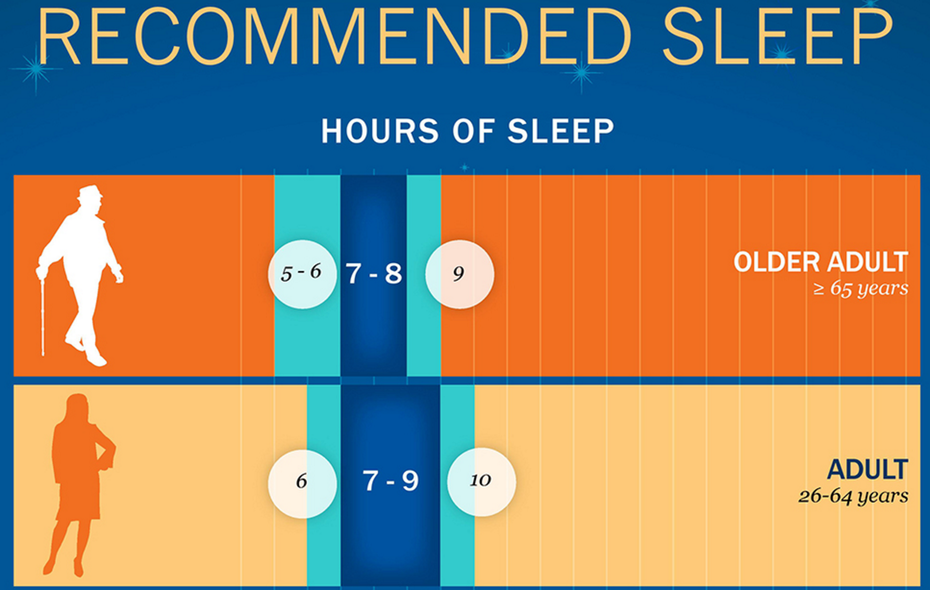
Know the Recommendations
Nutrition
Physical activity
(AHA/ASA, 2014)
Sleep (NSF, 2015)

Slide 22
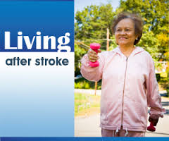
Secondary Stroke Prevention: Modifiable Factors

Slide 23
Stroke…….
5 Most Common Risk Factors
High blood pressure
Smoking
Abdominal obesity
Diet
Lack of physical activity
3rd cause of death worldwide
Results in mortality or disability in every 3rd patient at the end of the first year following an acute cerebrovascular event.
Notes:
The 5 most common cardiovascular risk factors are responsible for 80% of the cases
Niewada, M., & Czlonkowska, A. (2014). Prevention of ischemic stroke in clinical practice: A role of internists and general practitioners. Polskie Archiwum Medycyny Wewnetrznej, 124(10), 540-548.

Slide 24
Life Style Modification
A feature of stroke is recurrence
30–40% within five-years following first transient ischemic attack/ stroke.
A consistent, systematic assessment of stroke risk factors is lacking in clinical practice.
Notes:
Lawrence, M., Booth, J., Mercer, S., & Crawford, E. (2013). A systematic review of the benefits of mindfulness-based interventions following transient ischemic attack and stroke. International Journal of Stroke, 8(6), 465-474. doi:10.1111/ijs.12135
Although much is known about modifying risk factors to prevent first stroke (primary prevention) or recurrent stroke (secondary prevention), too often a consistent, systematic assessment of stroke risk factors is lacking in clinical practice (Mayo Clinic, 2016)

Slide 25
Life Style Modification
Helping patients commit to lifestyle changes that they themselves have selected have shown positive results
Motivational Interview
Patient Centered
Notes:
http://www.mayoclinic.org/medical-professionals/clinical-updates/neurosciences/secondary-stroke-prevention-toward-new-model-care
http://www.mayoclinic.org/medical-professionals/clinical-updates/neurosciences/secondary-stroke-prevention-toward-new-model-care
http://www.uspreventiveservicestaskforce.org/Page/Document/RecommendationStatementFinal/aspirin-for-the-prevention-of-cardiovascular-disease-preventive-medication#Pod2

Slide 26
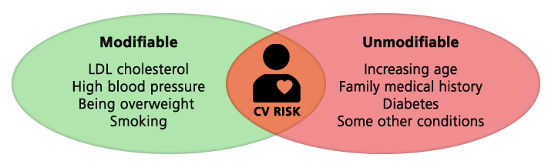
Modifiable Risk Factors

Slide 27
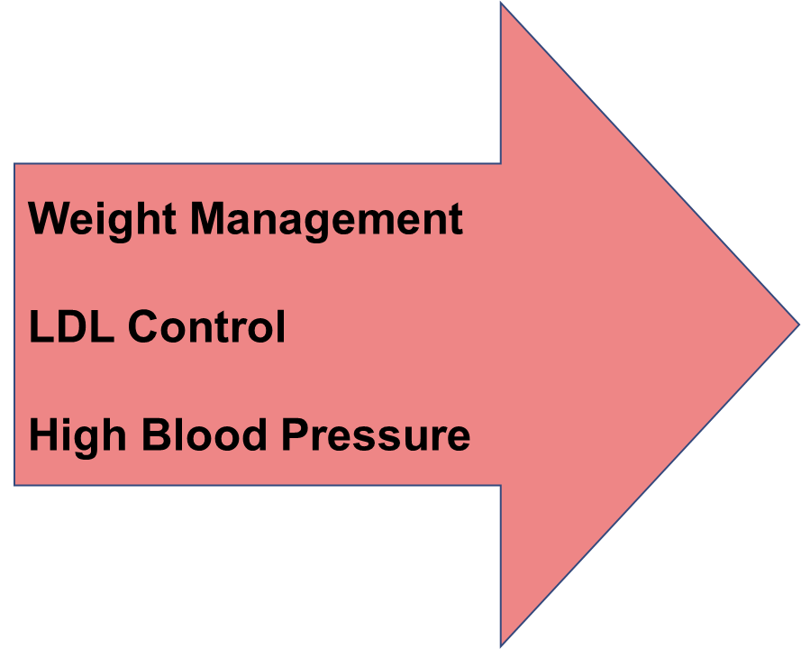
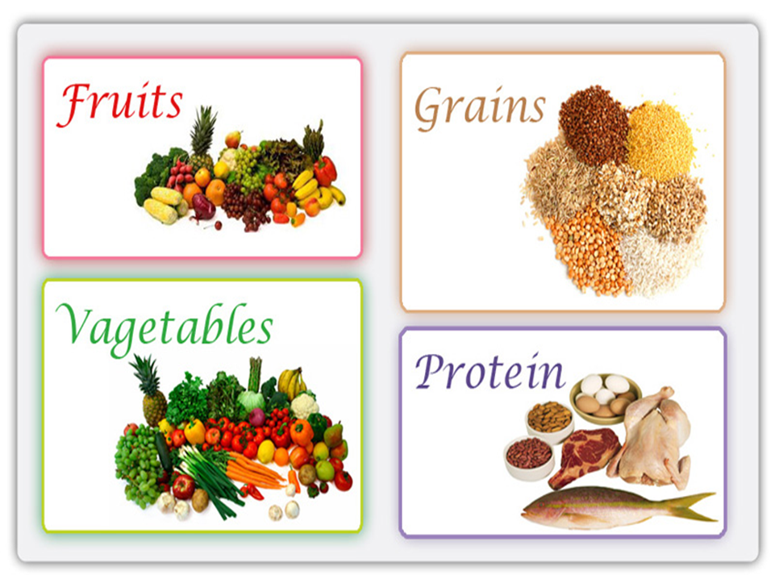
Life Style Modification: DIET
Notes:
These modifiable risk factors are measurable

Slide 28
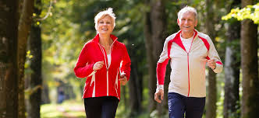
Life Style Modification: PHYSICAL ACTIVITY
Engage in Physical Activity Each Day :
Total of 60 minutes for children
30 minutes for adults
Notes:
Physical activity is an essential component of a healthy lifestyle. In combination with healthy eating, it can help prevent a range of chronic diseases, including stroke, heart disease, And even cancer, which are the three leading causes of death.
Engage in physical activity each day : a total of 60 minutes for children, 30 minutes for adults
http://stroke.ahajournals.org/content/early/2014/04/30/STR.0000000000000024.full.pdf+html

Slide 29

Life Style Modification: Smoking Cessation
Smoking can……..
Raise triglycerides
Lower "good" cholesterol (HDL)
Cause thickening of blood, making likely to clot
Increase the buildup of plaque in blood vessels
Thicken and narrow blood vessels
Notes:
How is smoking related to stroke………..
Raise triglycerides (a type of fat in your blood)
Lower "good" cholesterol (HDL)
Make blood sticky and more likely to clot, which can block blood flow to the heart and brain
Damage cells that line the blood vessels
Increase the buildup of plaque (fat, cholesterol, calcium, and other substances) in blood vessels
Cause thickening and narrowing of blood vessels
The Centers for Disease Control and Prevention (2016). Smoking and heart disease and stroke. Retrieved from: http://www.cdc.gov/tobacco/campaign/tips/diseases/heart-disease-stroke.html
http://www.cdc.gov/tobacco/campaign/tips/diseases/heart-disease-stroke.html

Slide 30
Mindfulness-Based Interventions:
Stress Management
Emerging evidence demonstrates an association between self-perceived psychological stress and ischemic stroke
Goal: Equipping patients with skills and coping strategies to help manage perceived psychological stress

Slide 31

Mindfulness-based stress reduction (MBSR) & mindfulness-based cognitive therapy (MBCT)
↑ BP in arteries
Intestinal muscles relax
Heart Rate ↑
STRESS HORMONES
Pupils dilate
↑ blood sugar
↑ blood flow to skeletal muscles
↑ breathing rate
https://www.youtube.com/watch?v=pZHLOU9cpk8&list=PLGdQqCObI6hc_loyiGBWvfUh6c9RPxDbJ&index=20
https://www.youtube.com/watch?v=dd6ktroFf8Q

Slide 32

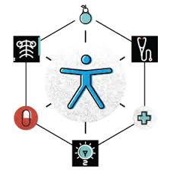
Supporting Health Promoting Behaviors
Physician-centered care relies on the physician who makes the
healthcare decisions and it relies on a hierarchical relationship
between the physician and the patient.
Patient-centered care changes this relationship from “what’s the matter” to
“what matters to you”. This type of care empowers the patient to take a more
active role in their health care.

Slide 33
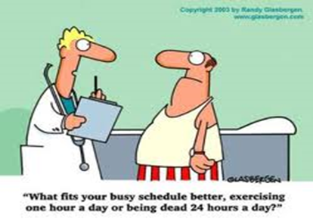
Motivational Interviewing
Motivational interviewing is a technique that elicits from the patient their own motivations for making behavioral changes which can have a beneficial impact on their overall health (Rollnick, Miller, & Butler, 2008).
Motivational interviewing, grounded in
patient-centered care, focuses on what the
patient thinks, wants, and feels.

Slide 34


Motivational Interviewing in Action
https://www.youtube.com/watch?v=dm-rJJPCuTE

Slide 35
Six Steps of Instance Influence
Step 1: Why might you change?
Step 2: How ready are you to change- on a scale from 1/10, where 1 means “not ready at all” and 10 means “totally ready”?
Step 3: Why didn’t you pick a lower number? (Or if they picked a 1, either ask the second question again, this time about a smaller step toward change, or ask, what would it take for that 1 to turn into a 2?)

Slide 36
Six Steps of Instant Influence
Step 4: Imagine you’ve changed. What would the positive outcomes be?
Step 5: Why are those outcomes important to you?
Step 6: What’s the next step, if any?

Slide 37

Literature Review
Positive evidence in addiction
Results mixed in chronic health conditions
New studies in using MI after stroke
Need more RCT’s

Slide 38
Questions?

Slide 39
References
American Diabetes Association. (2016). Standards of medical care in diabetes- 2016. The Journal of Clinical and Applied Research, 39(1) http://care.diabetesjournals.org/site/misc/2016-Standards-of-Care.pdf
CDC. (2016). Adult immunization schedule. Retrieved from http://www.cdc.gov/vaccines/schedules/hcp/adult.html
The Centers for Disease Control and Prevention (2016). Smoking and heart disease and stroke. Retrieved from: http://www.cdc.gov/tobacco/campaign/tips/diseases/heart-disease-stroke.html
Healthteam Works Videos. (2009, 10,9). Motivational Interviewing: Evoking Commitment to change. [Video file]. Retrieved from https://www.youtube.com/watch?v=dm-rJJPCuTE
Lawrence, M., Booth, J., Mercer, S., & Crawford, E. (2013). A systematic review of the benefits of mindfulness-based interventions following transient ischemic attack and stroke. International Journal of Stroke, 8(6), 465-474. doi:10.1111/ijs.12135
Mayo Clinic .(2016). Secondary stroke prevention: Toward a new model of care. Clinical Updates. Retrieved from http://www.mayoclinic.org/medical-professionals/clinical-updates/neurosciences/secondary-stroke-prevention-toward-new-model-care
National Sleep Foundation. (2015). National sleep foundation recommendations new sleep durations. Sleep Health: The Journal of the National Sleep Foundation.
Niewada, M., & Czlonkowska, A. (2014). Prevention of ischemic stroke in clinical practice: A role of internists and general practitioners. Polskie Archiwum Medycyny Wewnetrznej, 124(10), 540-548.
Pantalon, M. (2011). Instant influence: How to get anyone to do anything fast. New York, NY: Little, Brown, and Company, Hatchette Book Group.
Rollnick, S., Miller, W.R., & Butler, C.C. (2008). Motivational interviewing in health care. New York, NY: The Guilford Press.
Stone, N.J. et al. (2013). ACC/AHA guideline on the treatment of blood cholesterol to reduce atherosclerotic cardiovascular risk in adults: a report of the american college of cardiology/american heart association task force on practice guidelines. Circulation. 01, doi:10.1161/01.cir.0000437738.63853.7a

