Slide 1
Effects of Lifetime Case Management in Survivors of Moderate to Severe Brain Injury: Lessons from the Minneapolis VA Brain Injury Wellness Program
Shawn McLaughlin DPT
Diane Mortimer MD, MSN
Tamara Paulson LCSW

Slide 2
Objectives
Discuss biopsychosocial complications of moderate to severe brain injury.
2) Describe the Lifetime Case Management model
3) Describe an interdisciplinary rehabilitation team to manage chronic brain injury.
4) Discuss potential drawbacks and benefits of this model of care in both veterans and civilians with brain injuries.

Slide 3
Part 1
Discuss biopsychosocial complications of moderate to severe brain injury.
Notes:
VAMC: VA Medical Center
STSG: Split Thickness Skin Graft

Slide 4
Significance
In the US:
as many 50,000 people survive severe TBI every year.
There are an estimated 5.3 million severe TBI survivors
Notes:
VAMC: VA Medical Center
STSG: Split Thickness Skin Graft

Slide 5
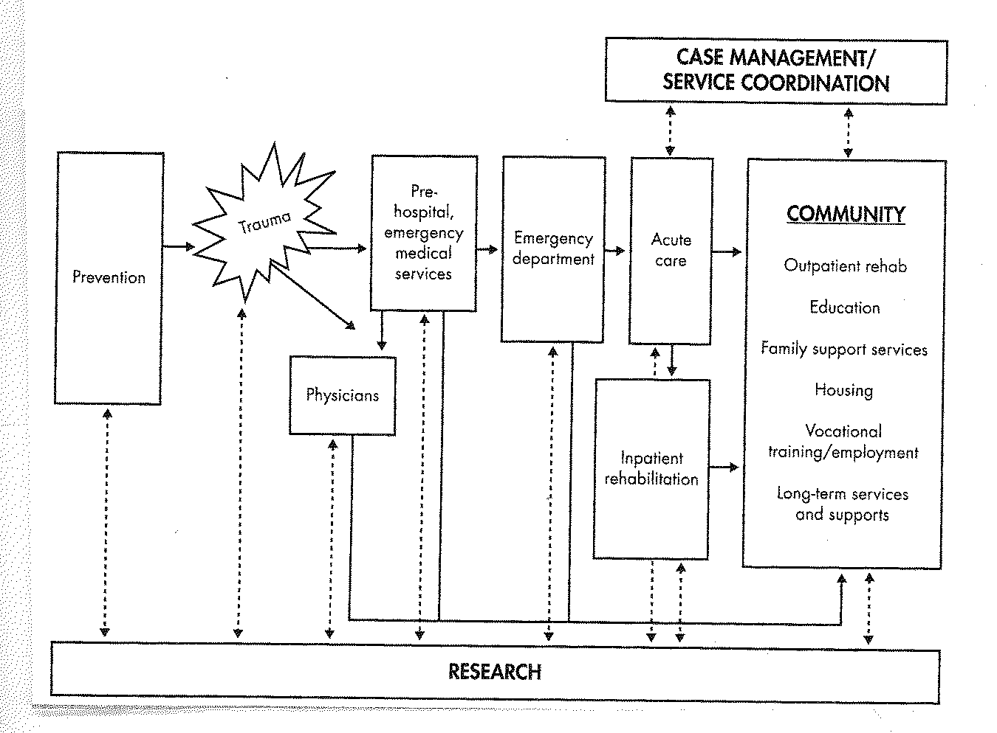
Continuum of TBI Care

Slide 6
Significance/ background
NIH Consensus Statement on Rehabilitation of People with TBI, 1998:
-people with TBI should have access to rehabilitation services through the entire course of their recovery, which may last for many years after the injury
-community-based, nonmedical services should be components of the extended care and rehabilitation available to people with TBI

Slide 7
Significance/ background
Individuals who recover from moderate to severe traumatic brain injuries are at risk for a host of long-term problems.
Individuals require management of complex problems
Re-injury and re-hospitalization are common, but at least in part, preventable

Slide 8
Significance/ background
Aging after a brain injury (even many years later) includes special challenges
Decreased cognitive reserve
Change in mobility
Medical sequelae and new problems
Care coordination issues

Slide 9
Common medical complications
Seizures/ post traumatic epilepsy
Endocrine abnormalities
Metabolic changes/ problems
Wound issues
Headaches
Sleep problems
Nutrition issues
Hearing, vision and olfaction/ smell issues
Balance and dizziness problems
Pain, Musculoskeletal issues
Vision and hearing abnormalities

Slide 10
Decreased lifespan
Following moderate to severe TBI, life expectancy can decrease by nearly a decade

Slide 11
Other sequelae
impaired mobility
abnormal cognition
altered executive function
neuropsychiatric/ behavioral symptoms
speech and language problems

Slide 12
Potential late effects
Cognitive impairments
Disorders of movement

Slide 13
Risk of subsequent TBI
Following mild to moderate TBI, the risk of subsequent TBI increases by over 50%

Slide 14
Mental health sequelae
substance abuse
depression and anxiety
impaired community reintegration
increased risk for suicide

Slide 15
Legal issues
Potential for high risk, including criminal, behavior

Slide 16
Community re-entry
Individuals may need assistance returning to work or school

Slide 17
Vocational rehabilitation
There is a good evidence that voc rehab programs allow TBI survivors to return to work or productive activity earlier than without intervention
Less unemployment, less dependence, less mental health issues
Supported employment: employment specialist provides training, counseling and support at a job site
Can lead to subsequent skills generation and increased productivity

Slide 18
Family and caregiver issues
Caregivers often experience emotional stress
They may also deal with physical challenges
Family roles may be rearranged

Slide 19
Social issues
risk for unstable housing and homelessness

Slide 20
Community re-entry/ participation
Return to driving
Return to family roles
Return to community activities

Slide 21
Care Needs Over Time

Slide 22
TBI Services- on Waiver (vary by state)
Employment rehabilitation
Intensive behavioral support/ crisis support
Home modifications
Specialized medical equipment and supplies/ assistive technology
Nonmedical transportation
Respite care
Personal care/ attendant services
Skilled nursing
Home-delivered meals
Case management
Residential rehabilitation
Transitional living
Independent living skills training and development
Adult day care and/ or treatment
Home and community support services (supervision, companionship)
Psychological or behavioral counseling

Slide 23
Part 2
Describe the Lifetime Case Management model and its implementation by the Minneapolis VA Brain Injury Wellness Program’s interdisciplinary rehabilitation team.
Notes:
VAMC: VA Medical Center
STSG: Split Thickness Skin Graft

Slide 24
Brain Injury Wellness Program
275-300 Veterans with moderate to severe brain injury who live locally
Overriding goals: prevention and support

Slide 25
Brain Injury Wellness Program
Core Team Involvement (MD, RN, SW)
Minimum Contact-Annual Check-in’s
Maximum Contact-During crisis, we will interact with a Veteran on a daily/weekly basis
Community Visits as well as phone and medical center appointments

Slide 26
Program Rationales
Facilitate coordination of care across multiple providers, medical treatments, and systems
Prevent foreseeable untoward events
Identify and address complications as early as possible
Provide support in psychosocial situations like need for financial, housing and social resources
Construct and maintain effective and collaborative team

Slide 27
How does it work?
Every participant has an assigned core team
Rehabilitation Physician or Nurse Practitioner
Social Work Case Manager
Nurse Case Manager
Participant or caregiver can contact this team directly with questions/needs
Face to Face, phone or emails/ secure message

Slide 28
How does it work?
Participants have heterogeneous needs
Needs change and switch; some needs are intensive for one week while other are not for several years
They continue on our caseload regardless
RN and SW case management work closely together and will often triage for one another
SW will call RN with Patient needs that are medical in nature
RN will call SW with Patient needs that are psychosocial in nature

Slide 29
Psychosocial Challenges
Need for further education on brain injury
Lack of financial resources or income
Housing
Need assistance in finding housing
Current housing unsafe or not accessible
Aging with Brain Injury
Advanced Directives
Transitioning to increased care
Referrals for services (Homemaking, HHA, ILS, and others)

Slide 30
Some Psychosocial Interventions
Wellness Group
Group of 10-12 Veterans who are currently served by the Wellness Clinic Lifetime Case Management Model
Recreational / Social / Education Based
Weekly meetings for one hour
Assistance in initiation
Often we just start the process and work with Veteran to continue it on (paperwork, discussion of situation, and others)

Slide 31
Part 3
Describe an interdisciplinary rehabilitation team to manage chronic brain injury.
Notes:
VAMC: VA Medical Center
STSG: Split Thickness Skin Graft

Slide 32
Our Team
Physicians
Nurse Case Managers
Social Workers
Rehabilitation Psychologist
Vocational Rehabilitation Specialist
Speech/Language Pathologist
Occupational Therapist
Physical Therapist
Recreational Therapist

Slide 33
Provider’s Role
The provider visits can be with physician, nurse practitioner or nurse case manager
Seen by provider for:
acute illness -more pain
having seizures -worse confusion
Notes:
They’re seen by provider when issues come up (eg if acutely ill, having seizures, more pain, worse confusion etc). this can be initiated by family, the veteran, an outside source (eg nursing home, or group home staff who notice a difference, primary care team too)

Slide 34
Provider, continued
For “non-acute” concerns veterans are generally seen:
every 6-12 months
focus is on assessment of current status and prevention of additional problems
Provider’s also keep track of medications, and renew/ refill medications as indicated between appointments

Slide 35
Nurse Case Manager’s Role
Lifelong case management
Assist with monitoring and managing of the physical, behavioral, emotional, and psychological comorbidities
Point of contact for patients, family members, and caregivers
Assist patients in coordinating their
Help track/ manage medications and prescriptions

Slide 36
Nurse Case Manager, continued
Provide ongoing health education/coaching
Ensures that there is continuity of care within our clinic, primary care, and other specialty care clinics
Help to identify barriers to optimal functioning
Notes:
We frequently assess our clients’ level of knowledge as it relates to their health status and provide ongoing health education/coaching with a main goal of early prevention and identification of chronic illness. The RN Case Manager assesses the patient holistically and assures that there is adequate continuity of care within our clinic, primary care, and other specialty care clinics. We help to identify barriers to optimal functioning of our patients (i.e. transportation, housing, financial, equipment needs). The RN Case Manager also assists with triaging medical emergencies, assists with post-acute care discharge planning, assists with novel problem solving, and helps interdisciplinary team/patients establish realistic goals to achieve optimal outcomes. Wellness patients are seen in RN Clinic for early detection and determination of healthcare needs, establishing a plan of care, and monitoring progress and outcomes.

Slide 37
Social Worker’s Role
Lifetime Case Management
support and improve functional living skills and to mitigate crises
Primary case manager for emerging medical, psychosocial, or rehabilitation problems
Serve as a key liaison with the interdisciplinary team
communicating patient-centered goals
Manage the continuum of care and provide care coordination
Patient and family advocate
Assess clinical outcomes and satisfaction.
Notes:
Lifetime case management in the TBI Wellness Program is designed to support and improve functional living skills and to mitigate crises. This includes acting as the primary case manager for emerging medical, psychosocial, or rehabilitation problems; serving as a key liaison with the interdisciplinary team; communicating patient-centered goals to key stakeholders; managing the continuum of care and providing care coordination; acting as a patient and family advocate; and assessing clinical outcomes and satisfaction. The social work case manager also acts as a consultant and resource for community agencies, military points of contact, other VA medical centers/clinics, and the Department of Defense. In assisting and supporting veterans in living in the least restrictive environment and with the most autonomy as possible, case managers assist veterans with financial problems, transportation issues, housing/homelessness, and VBA benefits and claims. The TBI social worker also tracks veterans listed in the National TBI Registry Database and is responsible for data collection and action plans related to TBI Performance Measures.

Slide 38
Social worker, continued
Consultant and resource for:
Community agencies
Military points of contact
Other VA medical centers/clinics
Department of Defense.
Other roles that they assist in:
Support veterans in living in the least restrictive environment
Financial problems
Transportation issues
Housing/homelessness
VBA benefits and claims
National TBI Registry Database
TBI Performance Measures.

Slide 39
Rehab Psychologist’s Role
Provides individual, couples, and family treatment
Assists with common issues to individuals with TBI, as well as issues commonly experienced by veterans
Depression
Anxiety
Behavioral management
Anger management
Substance abuse
PTSD
Complex pain
Notes:
Rehabilitation Psychology is an integral part of the Wellness Team. We are fortunate to be able to provide individual, couples, and family treatment to assist in the evolution of adjustment to disability across the life span. These include issues common to individuals with TBI, as well as issues commonly experienced by veterans (i.e., depression, anxiety, behavioral management, anger management, substance abuse, PTSD, complex pain—and the impact of their interaction within the context of TBI). The rehabilitation psychologists adapt numerous evidenced-based treatments, particularly for PTSD, for individuals with TBI. Rehabilitation Psychology often has long-term therapeutic relationships with Wellness patients and as such is poised for early detection and identification of changes and need for the veteran to re-engage in various services. The life-long Wellness Model allows the rehabilitation psychologists to assist veterans with TBI when faced with the new challenges that life presents: marriage, divorce, birth, death, new medical diagnoses such as cancer and end-of life issues, retirement, job loss, job gain, etc.

Slide 40
Rehab Psychologist, continued
Rehabilitation Psychology often has long-term therapeutic relationships with Wellness patients
Allows the rehabilitation psychologists to assist veterans with TBI when faced with the new challenges that life presents

Slide 41
Vocational Rehabilitation Specialist
Assists with obtaining a job, returning to work, or working towards finding another position.
Assist with providing career planning services, educational support and possible accommodations needed on the job.
Job Coaching for those that are currently working
Notes:
The Vocational Rehabilitation Specialist works with the team to provide vocational services to Veterans interested in working. The VRS assists Veterans in obtaining a job, returning to work, or working towards finding another position. VRS can also work with the Veterans to provide career planning services, educational support and possible accommodations needed on the job. For Veterans that are working or have recently obtained a new job, the VRS staff can provide job coaching as well as long-term job follow up services.
The VRS works closely with the team to assist the Veteran in ensuring success on the job. Work with the team to discuss barriers or issues that are affecting the Veteran to develop plans to assist the Veteran. If the Veteran is struggling on the job, work together with the team to ensure they are receiving the appropriate medical services needed to help the Veteran succeed.

Slide 42
Speech/Language Pathologist
Provide education related to cognitive and communication function
Evaluate current status
Treatment often centers on implementation of compensatory strategies
Notes:
we focus on providing veterans with education related to cognitive and communication function. We evaluate current needs of veterans at intake to determine treatment options. Treatment often centers on implementation of compensatory strategies such as using assistive technology devices for cognition.

Slide 43
Occupational Therapist
Provides education to assist one’s participation in daily tasks
Assists in improving daily functioning
Assists with cognitive deficits and learning compensatory strategies
Notes:
Occupational Therapy is the art and science of directing one’s participation in daily tasks to restore, reinforce and enhance performance, facilitate learning of skills and functions essential for adaptation and productivity, diminish or correct pathology and promote and maintain health. coping, acceptance and adjustment techniques, educational supports and study tactics, sleep hygiene, e a holistic, functional approach is utilized in treatment, incorporating cognitive, physical, psychosocial/emotional, behavioral, spiritual, vocational and avocational rehabilitative practices to improve the veteran’s daily functions.
Occupational Therapists utilize cognitive compensations, stress/anxiety management strategies, coping, acceptance and adjustment techniques, training in the use of study tactics and educational skills, treatment and compensations to aid the client in addressing life situations sleep hygiene and pain management methods and visual treatments and compensations to aid the client in addressing life situations and optimizing function.

Slide 44
Physical Therapist
Help veteran maximize function and access to community resources/recreation
Provides education and self-management tools for chronic pain modulation to assist with improving function
Evaluates the current status of patient or address current concerns
Re-Assess and manage functional declines with adaptations/compensation.
Work with other disciplines in order to help the veteran achieve their personal goals.

Slide 45
Recreational Therapist
Goal: providing empowerment through leisure and recreation with support, while integrating back into community programs.
Allows the ability for individuals to continue developing and enhancing their leisure lifestyle
May be seen 1:1 during clinic or community integration sessions or within groups
Notes:
Recreation Therapy in our TBI Wellness program offers the opportunity to Veterans to continue developing and enhancing their leisure lifestyle. Veterans consulted to receive Outpatient Recreation Therapy services meet one on one with Recreation Therapy Staff to conduct a formal assessment and develop goals for involvement in Recreation Therapy.
Veterans may be seen one on one during clinic or community integration sessions to address areas of leisure education, community resources, recreation participation, social skills and pragmatics, and adaptive equipment trials.
Veterans are also able to participate in weekly recreation participation groups such as; bowling, dart league, pool league, disc golf, or golf. There is a weekly Adaptive Yoga and Relaxation class that teach mind-body skills, social support and a regular relaxation practice. Wellness Groups offered weekly and is available to provide education, discussion and practical application of all topics related to health and wellness. Topics explored have included; social skills, conversation skills, volunteering, exercise, community resources, integrative health, and transportation.
In addition, Veterans are offered involvement in special events and community programs regularly such as; visiting the Minnesota State Fair, fishing trips, sponsored events at local Veteran Service organization facilities, sporting events, and other special events throughout the local community. The ultimate goals is providing empowerment through leisure and recreation with support, while integrating back into community programs.

Slide 46
Recreation therapy, continued
Able to participate in special events and community programs
Able to participate in weekly recreation participation groups
Wellness Groups offered weekly

Slide 47
Part 4
Discuss potential drawbacks and benefits of this model of care in both veterans and civilians with brain injuries.

Slide 48
benefits
Helps with chronic disease management, and TBI is arguably is a chronic disease
Can save money
Can prevent hospitalizations
Addresses social issues
Provides assistance to families

Slide 49
drawbacks
Arguably could create dependency
Cost
Lack of resources (not just money)

Slide 50
challenges to implementation
People can transition between providers and health systems
People can move
Charts/ medical records may not be available
Medication lists may be in multiple locations
People are often “lost to follow up”

Slide 51
Recreation therapy, continued
Able to participate in special events and community programs
Able to participate in weekly recreation participation groups
Wellness Groups offered weekly

Slide 52
Case Example # 1
Veteran in his 60s
Widowed with no children
Worked as a clerk prior to 2009
Past incidents involving Traumatic Brain Injury
Hit in head during basic training in late 1960s
Was assaulted in early 1970s, hit on head with blunt object
At least two falls with concussions (while intoxicated)

Slide 53
Case Example # 1
-Began accessing the Outpatient Brain Injury Clinic.
Initial concerns included Short-Term Memory loss, and Balance Issues
Worked with SLP, OT, PT, rehab pscyh, provider and case managers
-Co-morbid conditions of alcohol use and mental illness
-Diagnosed with Prostate cancer in about a year later
-Developed subdural hematoma in fall while intoxicated about a year after that
-Acute Interdisciplinary Inpatient Rehab
-subacute rehab, then Medical Foster Home
-Then to Assisted living, a family member as guardian
-Transitioned back to Medical Foster Home about 3 years later

Slide 54
Case Example # 1
throughout all stages in care, the Outpatient Brain Injury Team has coordinated his care needs
Currently has four teams managing his care (Primary Care, Home Based Primary Care Team, Rehab TBI and Mental Health)
Maintains bi-annual appointments with Rehab Physician and Physical Therapist to monitor his functioning

Slide 55
Case Example # 2
Combat Veteran in his early 30s
Multiple combat deployments
In college, has completed 3 years
Single, no children
Some diagnosed anxiety and alcohol use
Severe TBI in motorcycle crash
Critical and acute care course at trauma center
long term acute care
To acute TBI inpatient rehab about 3 months later
Interdisciplinary rehabilitation

Slide 56
Case Example # 2
Admitted into Polytrauma Transitional Rehabilitation Program nearly 4 months later
Discharged home independently after about 2 months
Transitioned to Outpatient Brain Injury Clinic
Still being followed a Rehabilitation Provider, RN Case Manager and SW Case Manager
Also sees a Rehab Psychologist, Mental Health, Neurology, and Primary Care team
Outpatient Brain Injury Needs:
Coordination between clinics
Assistance negotiating psycho-social dynamics
Medication Renewals

Slide 57
summary
Survivors of moderate to severe brain injury face long-term challenges.
Persistent sequelae and late effects of injury often require multifaceted treatments.
Psychosocial difficulties can lead to additional problems.
Lifetime case management, provided by a collaborative interdisciplinary rehabilitation team, can minimize complications and optimize quality of life for these survivors.

Slide 58
Selected references
Ashley MJ, Connors SH. Managing patients with traumatic brain injury across a long and often difficult continuum of care. Care Management 2010; 16(3): 7-10.
Belanger H, Umomoto JM, Vanderploeg RD. The Veterans Health Administration system of care for mild traumatic brain injury: Costs, benefits and controversies. Journal of Head Trauma Rehabilitation 2009; 24(1): 4-13.
Demoratz MJ. Community reintegration following a brain injury. Care Management 2001; 7(5): 35-37.
Dijkers MP. Quality of life after traumatic brain injury: A review of research approaches and findings. Archives of Physical Medicine and Rehabilitation 2004; 85(Supp 2): S21-S35.
Fadyl JK, McPherson KM. Approaches to vocational rehabilitation after traumatic brain injury: A review of the evidence. Journal of Head Trauma Rehabilitation 2009; 24(3): 195-212.
Goodman DL, Durham R, Easterling P. Continuum of care approach to severe traumatic brain injury. Care Management 2002; 8(3): 31-36.

Slide 59
Selected references
Hibbard MR, Uysal S, Sliwinski M, Gordon WA. Undiagnosed health issues in individuals with traumatic brain injury living in the community. Journal of Head Trauma Rehabilitation 1998; 13(4): 47-57.
Lannin NA, Laver K, Henry K, Turnbull M, Elder M, Campisi J, Schmidt J, Schneider E. Effects of case management after brain injury: A systematic review. NeuroRehabilitation 2014; 35(4): 635-641.
Laver K, Lannin NA, Bragge P, Hunter P, Holland AE, Tavender E, O’Connor D, Khan F, Teasell R, Gruen R. Organising health care services for people with an acquired brain injury: An overview of systematic reviews and randomised controlled trials. BMC Health Services Research 2014; 14(1): 397-314.
Wade DT, King NS, Wenden FJ, Crawford S, Caldwell FE. Routine follow up after head injury: A second randomised trial. Journal of Neurology, Neurosurgery, and Psychiatry 1998; 65(2): 177-183.

Slide 60
Thank You!
diane.mortimer@va.gov

