Slide 1
Scientific and Clinical Implications of Vestibular Vertigo Post Brain Injury
Daniel Stam PT, DPT, CBIS
Catherine Weiler, MD, PhD

Slide 2
Significance of the Topic
Balance and dizziness issues following both traumatic and non-traumatic brain injury are high in prevalence
These complaints frequently remain unaddressed in early health care: and contribute to substantially poorer quality of life and increased risk for falls and injury
Initiation of early rehabilitation efforts during a very plastic phase of brain recovery may yield substantially different outcomes
If left unaddressed: disablement may become very chronic in nature

Slide 3
Significance of the Topic
Vestibular based vertigo and recovery will require greater time and complexity when brain injury is involved versus the non-brain injured population
In spite of present challenges: resources do exist to facilitate change in health care delivery and knowledge translation bench to bedside: in order to provide essential education to both health care professionals and patients

Slide 4
Course Objectives:
1. Introduce a basic neuro-anatomical picture of the peripheral and central vestibular system
Further consider how this “invisible symptom” influences other complex systems such as vision and cognition: critical areas in the return to societal roles following a brain injury
2. Explore the most common vestibular disorders following a brain injury and provide a brief discussion on how early intervention can significantly influence the entire rehabilitation course

Slide 5
Course Objectives:
3. Introduce the pivotal role of rehabilitation in both facilitating adaptive versus maladaptive neuroplasticity, and further improving the ability to return to home and community roles following injury
4. Provide a health care professional and patient perspective of living with a vestibular disorder

Slide 6
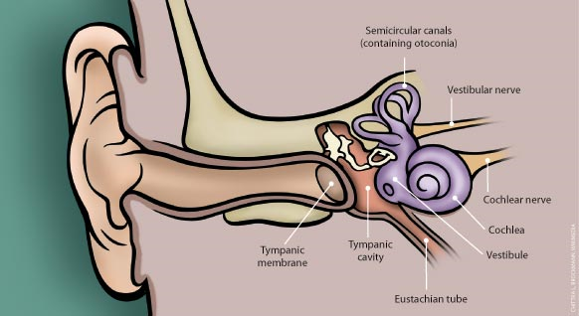
Basic Vestibular Anatomy Peripheral vestibular system
http://capefearpharmacy.com/blog/
Underlying the temporal bone is the vestibule (balance system) and cochlea (auditory system)
Information from the vestibular labyrinth is relayed to the brainstem and brain via the vestibular nerve

Slide 7
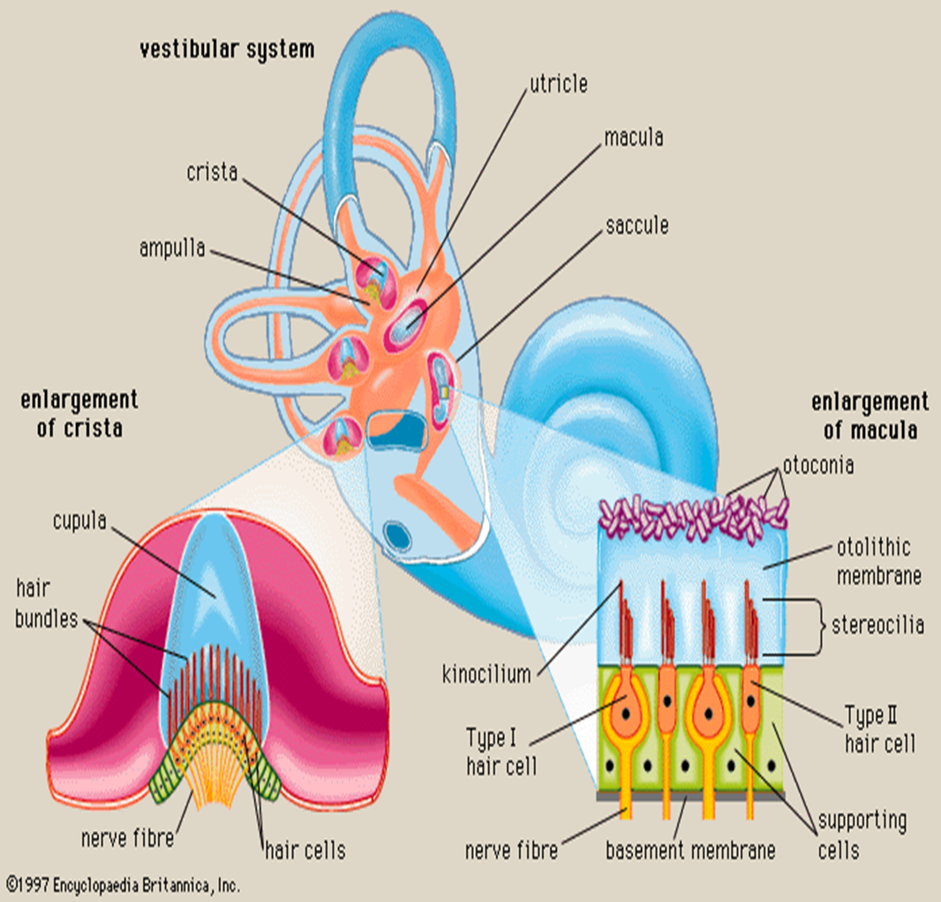
Vestibular Labyrinth: Semi-circular canals
www.skybrary.aero
3 semi-circular canals
Swellings/ampulla: houses the cupula: encases hair cells
These hair cells are the angular accelerometers which allow us to sense turning/rotation of the head

Slide 8
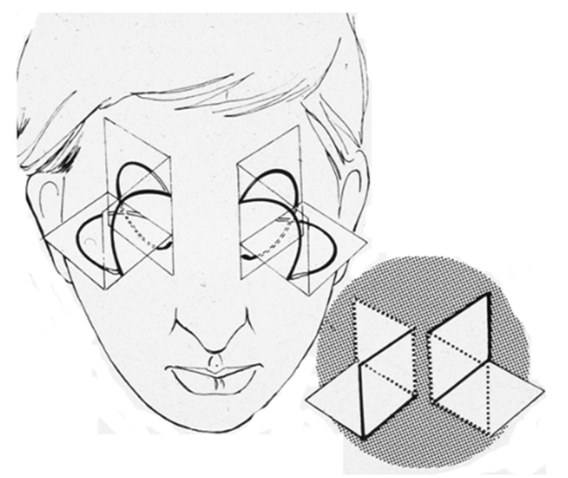
Vestibular Semi-circular Canals
Semicircular canals paired right and left according to geometric planes
Right posterior canal and left anterior canal are in the same plane-and work as a functional pair
The right and left horizontal canals are in the same plane-and work as a functional pair
Herdman SJ. Vestibular Rehabilitation. 3rd ed. Philadelphia, PA: FA Davis Company; 2007

Slide 9
Vestibular Semi-circular Canals
At rest we have tonic vestibular activity; however, when one canal is excited (during head turns in the plane of that canal) it’s contralateral partner is being inhibited
Example
This design allows for very precise knowledge of our head’s position in space
Herdman SJ. Vestibular Rehabilitation. 3rd ed. Philadelphia, PA: FA Davis Company; 2007

Slide 10
Vestibular Labyrinth: Otolithic organs
www.skybrary.aero
Two otolith organs: the utricle and saccule
Inside of the utricle are hair cells with an overlying gelatinous layer, with calcium crystals on top
This arrangement allows for sensing linear motion, or the position of the head in respect to gravity

Slide 11
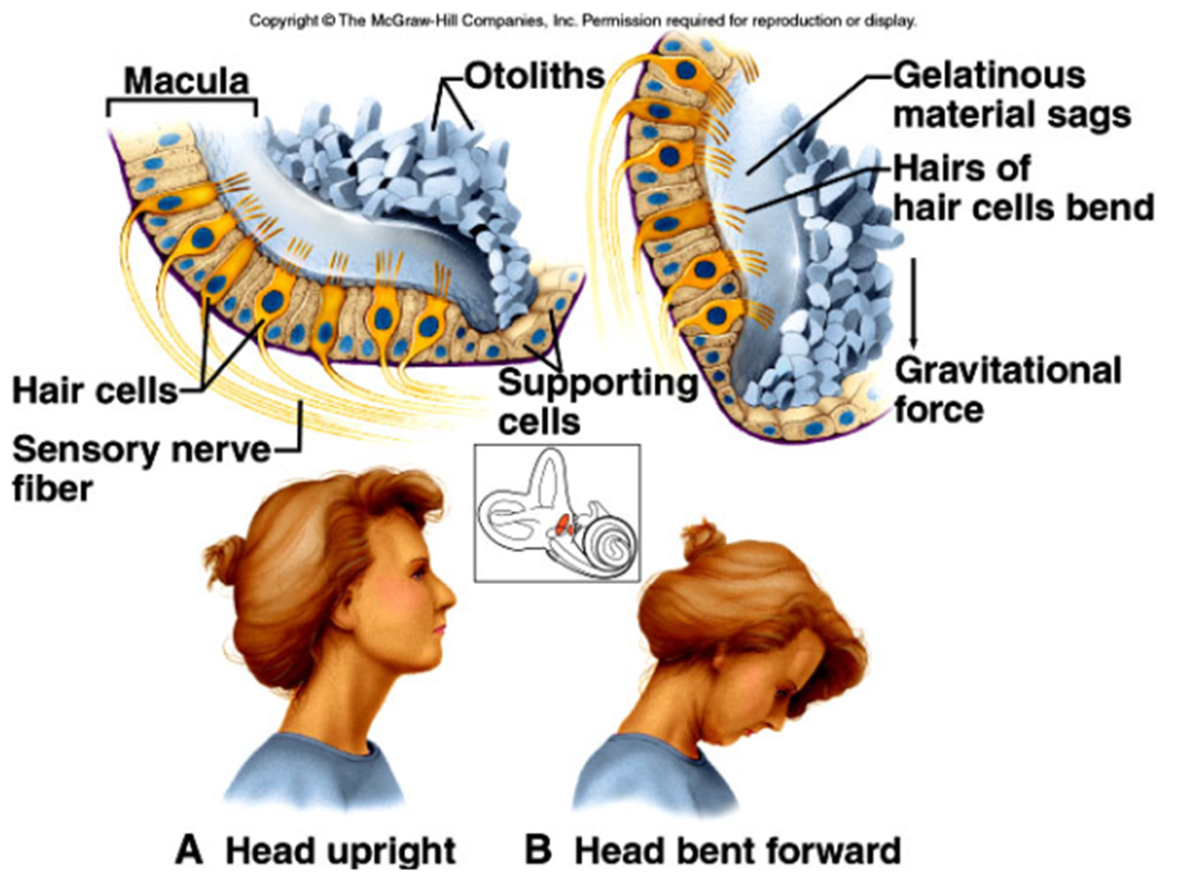
Vestibular Labyrinth: Otolithic organs
When the head is bent forward, gravity causes the calcium crystals to move downward within the organ
The gelatinous material sags, bending the sensory hair cells underneath generating a neural signal to the brain
http://people.emich.edu/pbogle/PHED_200/overheads/ch10_art/10_11.jpg

Slide 12
In review: the peripheral vestibular system is responsible for identifying both rotational and linear movements of the head in space
This combined with visual information yields an internal representation of a visual-spatial world around us within the brain: and is essential for navigating within that world

Slide 13
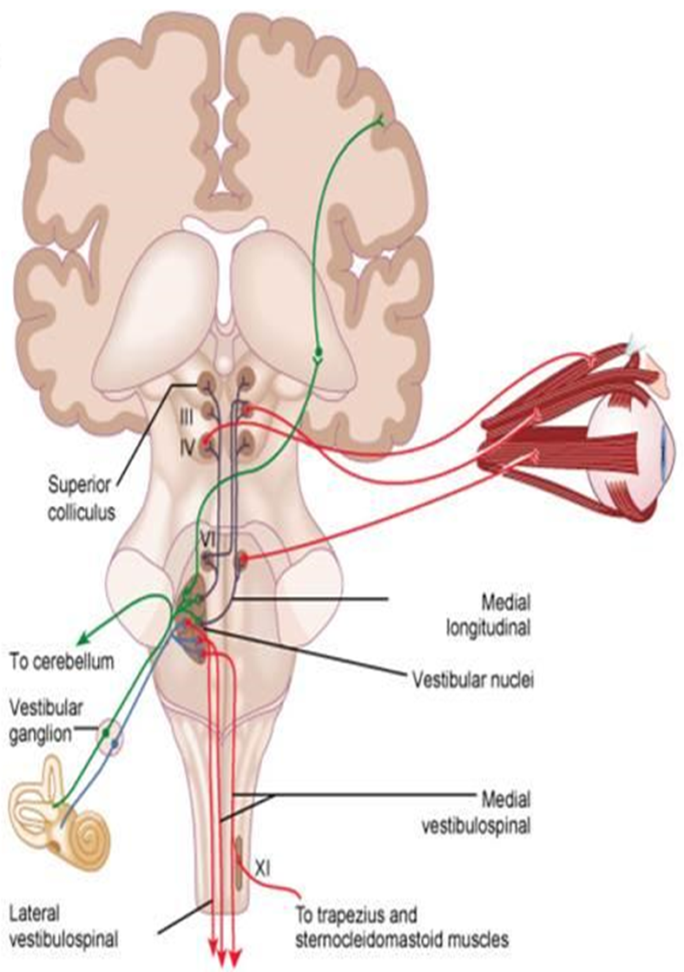
Basic Vestibular Anatomy Central vestibular system
Information from the inner ear is ascending and descending
Up through the brain stem to the opposite side of the cortex
Down through the spinal cord relayed to circuits related to gait and balance reactions
http://classconnection.s3.amazonaws.com/184/flashcards/1904184/jpg/picture111352569673168.jpg

Slide 14
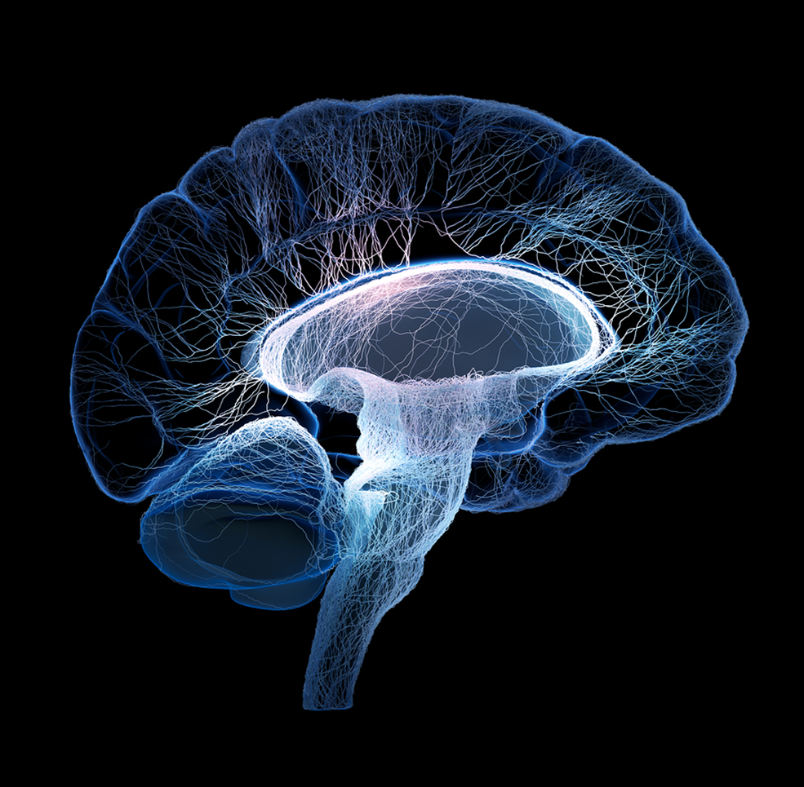
Basic Vestibular Anatomy Central vestibular system
jonlieffmd.com
From the brain stem, one information set is relayed to the cerebellum; another set extends to the cortex
The cerebellum compares information from the vestibular system to information from the visual system at a subconscious level
Mismatch: the result may be a perception of vertigo: the world spinning; or lack of awareness where you are in space

Slide 15
Basic Vestibular Anatomy Central vestibular system
jonlieffmd.com
The vestibular system is also neurally connected to regions of the brain central to vision (occipital lobe); spatial awareness (parietal-temporal lobe) and frontal regions of the brain correlated to cognition and emotion

Slide 16
Basic Vestibular Anatomy Review
Highly complex network involving an information chain from sensors in the inner ear, to neural networks extending to the cerebellum and brain stem as well as cortical brain regions involved in higher level information processing
The visual and vestibular systems are highly inter-connected: and vertigo is a result of a sensory mismatch between the eyes and inner ear generated from within the brain

Slide 17
Basic Vestibular Anatomy Review
Trauma or damage anywhere along this system may result in a vestibular disorder. Recovery will follow different trajectories, with damage to the central brain regions requiring increased time and higher complexity
Following traumatic brain injury: it is common to have both visual and vestibular vertigo: each type requiring a slightly different neuroscientific approach and requiring more than one discipline working together for the optimal outcome

Slide 18
Vestibular Influences to Additional Systems
Next we will review how the vestibular system influences 3 additional areas integral to brain injury rehabilitation:
1. Visual system
2. Cognition
3. Limbic system/behavioral and emotional control

Slide 19
System 1: Vestibular and Visual Connections
Many people following a vestibular disorder will find great difficulty focusing on objects in the visual environment with movement
This difficulty may create the perception of the world rotating around the person (vertigo); or objects in the visual environment bouncing up and down (oscillopsia) as they move
Double vision may also be common (diplopia)
These symptoms resolve when the person holds their head still or does not move

Slide 20
The natural response will be to avoid the things that make you feel the worst: in this case movement!
However this will rob the brain of its primary means towards recovery: adaptation (more on this later); and also rob the individual of their quality of life

Slide 21
Influence Upon Visual Acuity: Gaze stabilization
The ability to fixate our gaze on a stationary object while we turn our head is a vestibular driven response called the vestibulo-ocular reflex (VOR)
This is essential for most activities of daily living
A basic knowledge of how this works is essential understanding for working with vestibular disorders

Slide 22
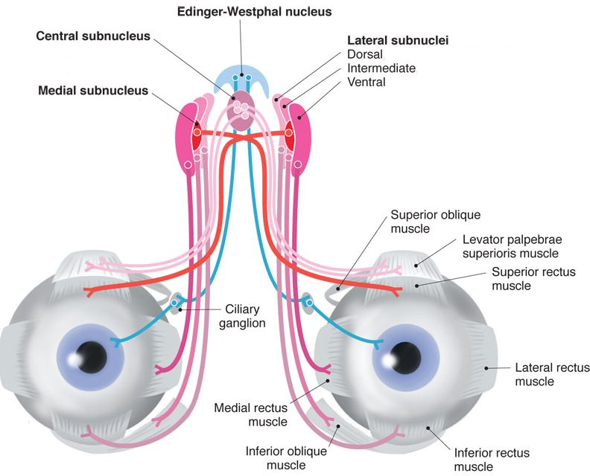
Visual Acuity Vestibulo-ocular reflex
www.seehint.com
When I turn my head to the right, the right vestibular nerve is excited (and left is inhibited)
This sends an excitatory signal that runs through the brain stem and connects to the eye muscles responsible for eye rotation to the left
The inhibitory signal from the left vestibular nerve travels to the eye muscles responsible for right eye rotation

Slide 23
Visual Acuity Vestibulo-ocular reflex
The result: when I focus my vision on an object in front of me, turn my head to the right: my eyes go to the left
When I turn my head to the left, my eyes go to the right
The gain of the vestibular system is 1: meaning that for every 1 degree of head movement, there is a corresponding 1 degree of eye movement in the opposite direction

Slide 24
Visual Acuity Vestibulo-ocular reflex
This is automatic: it is a reflex we don’t need to think about
However, when information from the vestibular system is inaccurate this reflex is not working properly and the eyes and head do not properly track/coordinate
Now the information being sent to the brain from the vestibular and visual systems do not match
This mismatch results in vertigo associated with movement, and head movement

Slide 25
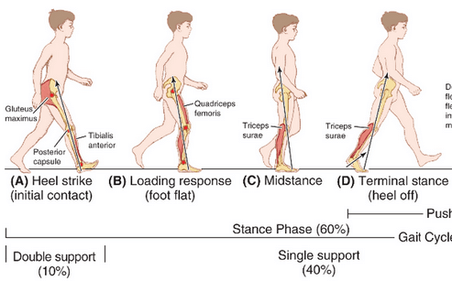
Visual Acuity Oscillopsia
Even walking with no head movements requires the VOR: when you consider the vertical displacement of the body’s center of mass as a natural component of gait
Thus the VOR is essential for everything we do from a mobility stand point
epomedicine.com

Slide 26
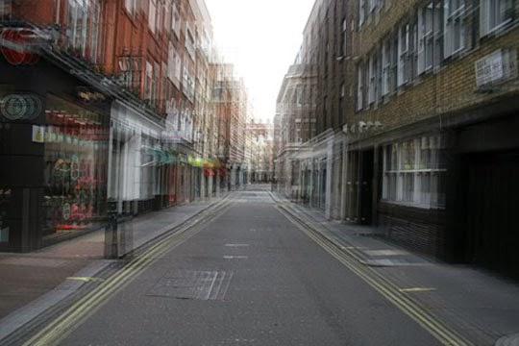
Visual Acuity Oscillopsia
www.mattsms.com
If you cannot keep the eyes still during this natural head movement: images cannot remain still on the retina. The result is that as you move, everything in your visual environment will bounce or appear to be “floating” in space

Slide 27
Visual Acuity Optokinetic stimulation
Being stationary but having visual movement within the environment: activates the vestibular system and VOR even though the head is not moving. It creates the illusion of movement and therefore can be profoundly problematic for those with vestibular disorders
Being in wide open environments with a busy visual surround (such as a grocery store, or theater, or church)
Working on a computer screen can also simulate a similar response and resulting vertigo

Slide 28
System 2: Vestibular and cognitive connections
Greater cognitive reserves and focus are now required to maintain balance, equilibrium, and stability: a process that prior to injury was automatic and subconscious
Cognitive fatigue: activities of daily living once completed with ease now tax the brain to the point of exhaustion; requiring greater duration of rest/sleep following activities
This strain may further deplete reserves for memory, attention/concentration, and executive functioning

Slide 29
System 3: Vestibular and Limbic System Connections
Through the brains neural circuitry: there exists a neurobiological link between the inner ear, through the pathways of the central vestibular system, to regions of the brain associated with emotion, learning, and psychosomatic conditioning responses

Slide 30
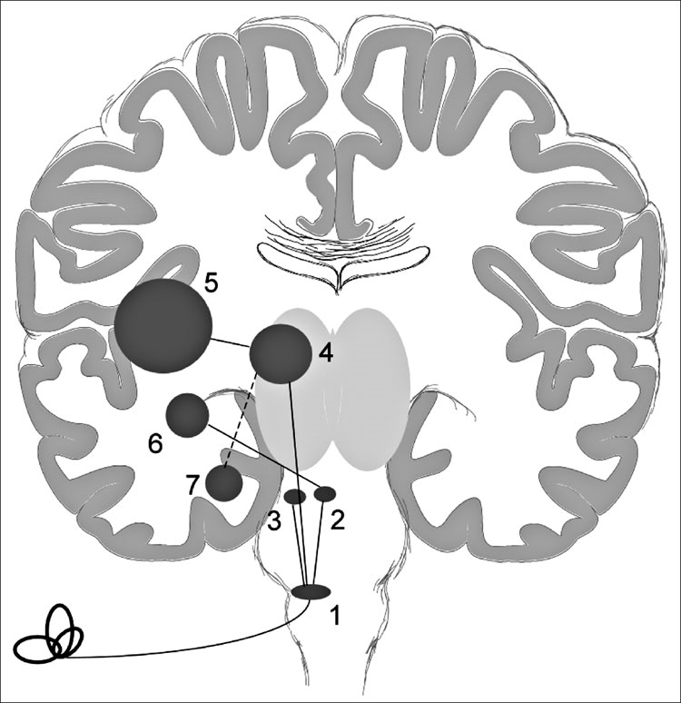
Limbic System Learning and conditioning pathways
Vestibular nucleus brainstem (1); thalamus relay center (4); hippocampus (7): area of brain associated with memory and learning
Vestibular nucleus (1); locus coeruleus brainstem (2); amygdala (6): implicated with fear/anxiety/conditioning responses
http://www.rehab.research.va.gov/jour/2012/497/franke497.html

Slide 31
Limbic System: Invisible symptoms?
This research has correlated vestibular dysfunction with depression and anxiety
“Emerging research suggests the vestibular system can be considered a potential window for exploring brain function beyond that of maintenance of balance, and into perception, cognition, and consciousness” (Gurvich et al, 2013)

Slide 32
Bottom line for health professionals:
Given a vestibular dysfunction following a brain injury the following considerations are necessary:
Vision may be influenced
Cognition may be influenced
Emotion and anxiety responses may be influenced
This in addition to the physical component of balance

Slide 33
Bottom line for health professionals:
These are real symptoms with a neuro-anatomical basis. Invisible symptoms experienced by the patient require a combination of clinical scientific knowledge, and also patience, compassion and understanding in terms of how this influences a person as a whole

Slide 34
Vestibular etiologies following post-traumatic and non-traumatic brain injury
Peripheral: Involve either the inner ear, or the peripheral nerve running from the inner ear to the brain
Central: Result from damage of neural pathways from the inner ear to the processing components of the brain

Slide 35
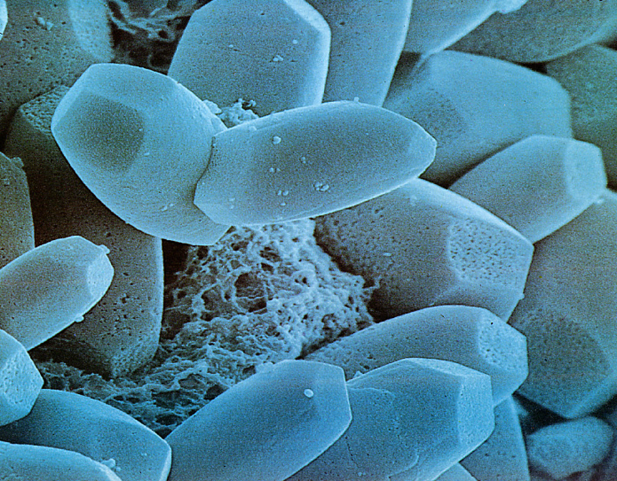
Post-Traumatic Benign Paroxysmal Positional Vertigo (BPPV)
Calcium crystals from otolith organs break loose and spill into the semicircular canals as a result of trauma
This debris, termed otoconia, may either be free floating within the semi-circular canals (canalithiasis), or adherent to the cupula of the semi-circular canal (cupulolithiasis)
http://anatomy.yonsei.ac.kr/slide/histo/SpecialSense_2003.files/slide0092_image137.jpg

Slide 36
Post-Traumatic Benign Paroxysmal Positional Vertigo (BPPV)
BPPV is classically characterized by subjective complaints of either vertigo or disequilibrium, in addition to objective findings of intermittent nystagmus, precipitated by positional changes of the head
Specifically getting into and out of bed, and rolling in bed
http://anatomy.yonsei.ac.kr/slide/histo/SpecialSense_2003.files/slide0092_image137.jpg

Slide 37
Benign Paroxysmal Positional Vertigo
Canalithiasis: most common
When the affected ear is put below the horizon, the crystals move to the most dependent position of the canal creating an abnormal and brief fluid motion, exciting the sensory hair cells and giving the false illusion of head motion
Lasts less than 60 seconds
www.tinnitusjournal.com

Slide 38
Benign Paroxysmal Positional Vertigo
Cupulolithiasis: less common
Otoconia adhere to the cupula of the semicircular canal, making the ampulla gravity sensitive
This produces an inappropriate deflection of the cupula when head is positioned with the affected ear below the horizon
Does not relent
www.tinnitusjournal.com

Slide 39
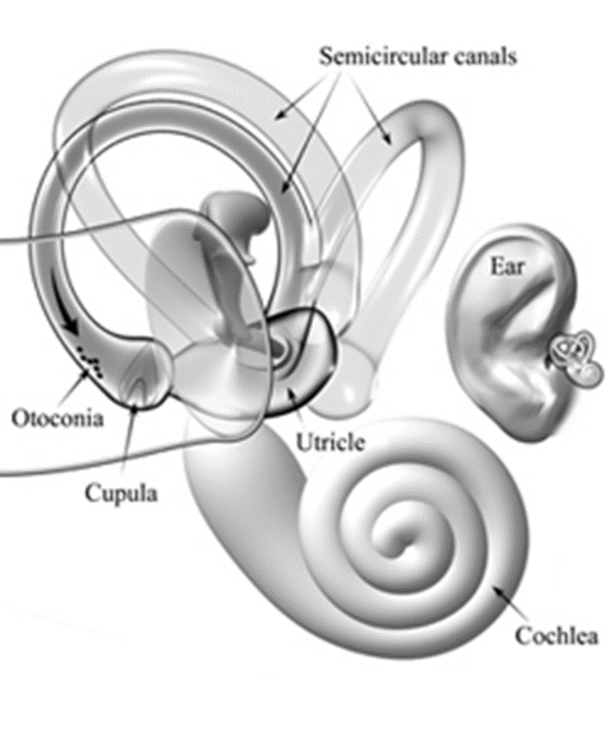
Post Traumatic Benign Paroxysmal Positional Vertigo
BPPV is the most common cause of dizziness post traumatic brain injury
Traditionally, individuals receiving vestibular rehabilitation for these dizziness complaints post-TBI as a group have demonstrated poorer clinical outcomes and significantly increased time required for symptom resolution
my.clevelandclinic.org

Slide 40
Post Traumatic Benign Paroxysmal Positional Vertigo
More recent studies exploring differences between idiopathic BPPV, and post-traumatic BPPV involving head injury, have implied a slightly differing pathophysiology with increased complexity for successful treatment
my.clevelandclinic.org

Slide 41
Post Traumatic Benign Paroxysmal Positional Vertigo
A 2012 study finding that in contrast to idiopathic BPPV, in which 84% of patients were symptom free in one single repositioning maneuver, only 35% of patients’ in the post-traumatic group were symptom free within the same time frame (Lui, 2012)
my.clevelandclinic.org

Slide 42
Post Traumatic Benign Paroxysmal Positional Vertigo
During a single year follow-up, 67% of post-traumatic presentations reported recurrence of BPPV following successful resolution, versus a 12% recurrence rate in the idiopathic group (Lui, 2012)
Additionally, post traumatic BPPV may demonstrate greater incidence of multi-canal variant or bilateral BPPV (Katsarkas, 1999)
my.clevelandclinic.org

Slide 43
Post Traumatic Benign Paroxysmal Positional Vertigo
Furthermore, challenges such as orthopedic and medical restrictions, profound cognitive impairments, agitation, or the inability of the patient to verbalize current symptoms may present significant barriers to many traditional means of assessment and intervention
my.clevelandclinic.org

Slide 44
Post Traumatic Benign Paroxysmal Positional Vertigo
If left untreated, BPPV may contribute to increased agitation with functional mobility, and perhaps maladaptive neuroplasticity in the acute rehabilitation environment
Imagine having vertigo and nausea/vomiting every time a nurse or therapist gets you out of bed: and you can’t verbalize what you are feeling
Example
my.clevelandclinic.org

Slide 45
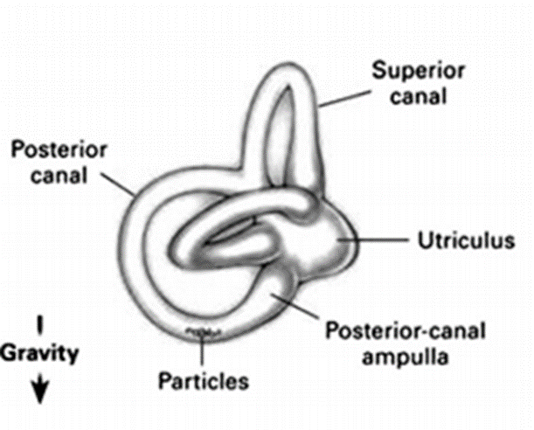
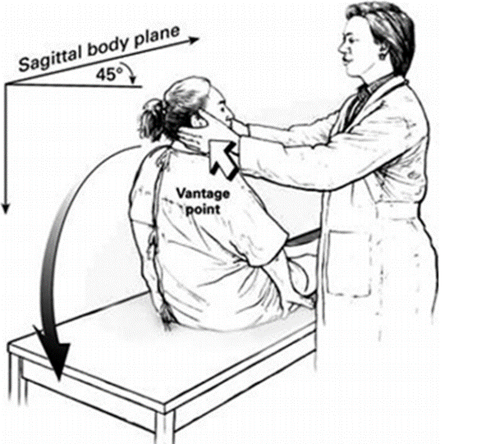
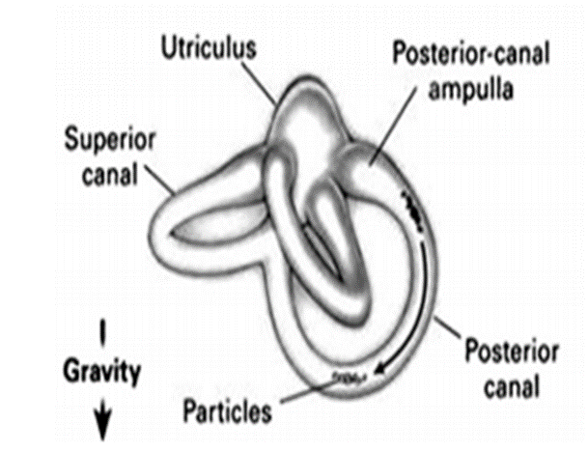
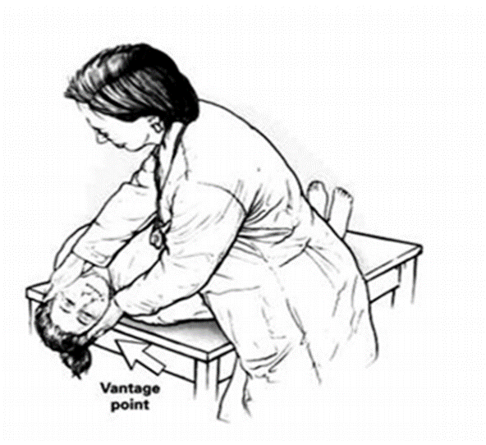
Established maneuvers exist that take advantage of the semi-circular canal geometry
By moving the head in specific patterns, the crystals can be moved through the entire circumference of the semi-circular canal back to the utricle where they are re-absorbed
Bhattacharyya et al, 2008

Slide 46
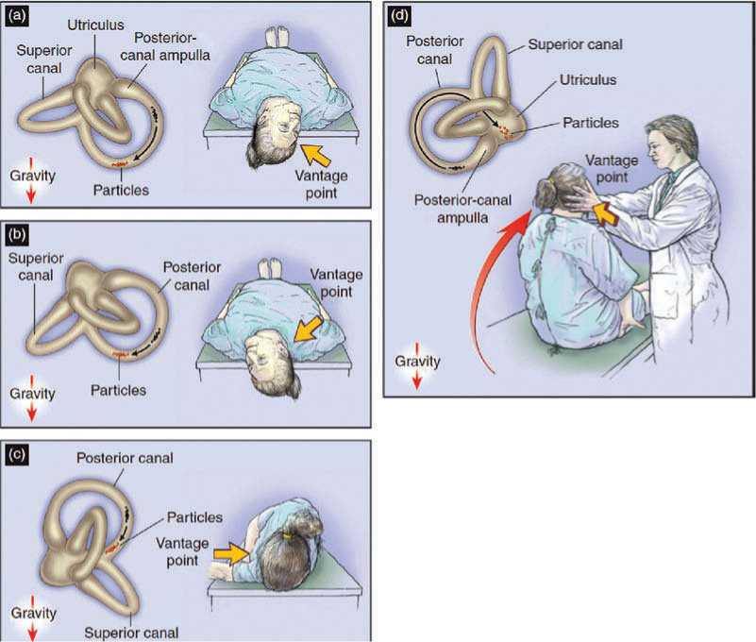
aibolita.com

Slide 47
Many of these conventional techniques cannot be used with patients acutely following brain injury given secondary limitations (agitation, orthopedic restrictions, medical restrictions)

Slide 48
My research interest is primarily how the science (physics) may be applied to accommodate these restrictions in acute hospital care, and effectively eliminate a brain injured persons vertigo (and subsequent vomiting) with bed mobility: often in 1-2 treatment sessions, even if they cannot verbalize their present symptoms

Slide 49
My most recent publication being in the Journal of Acute Care Physical Therapy: being a case study in which conventional techniques were not appropriate given motor agitation and orthopedic restrictions
Based upon eye movements: I was able to infer involvement of the right horizontal canal with debris adherent to the cupula

Slide 50
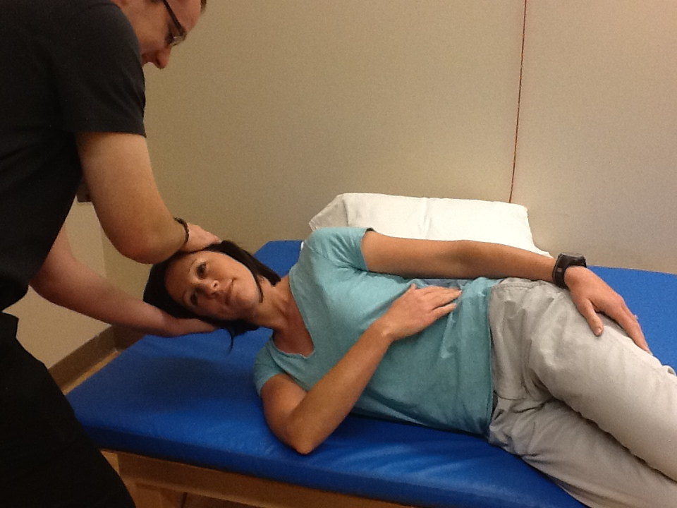
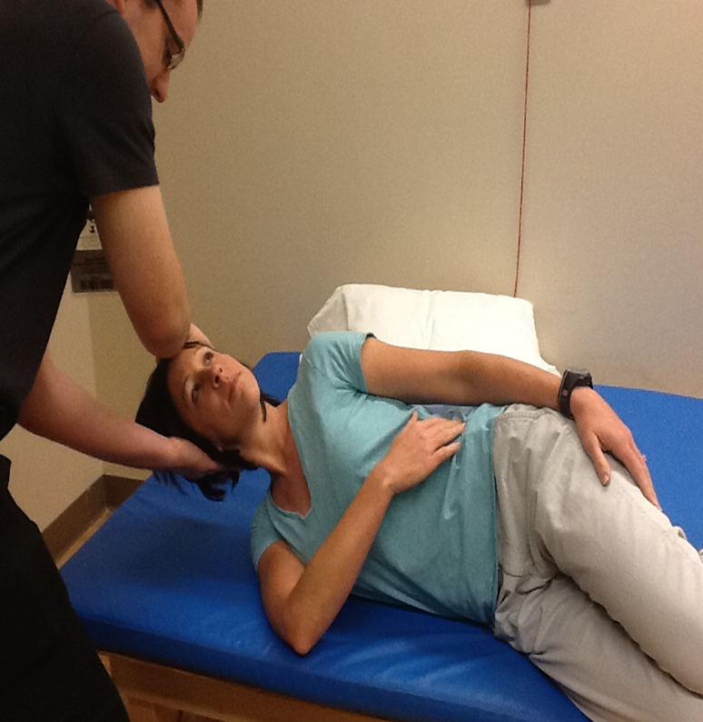
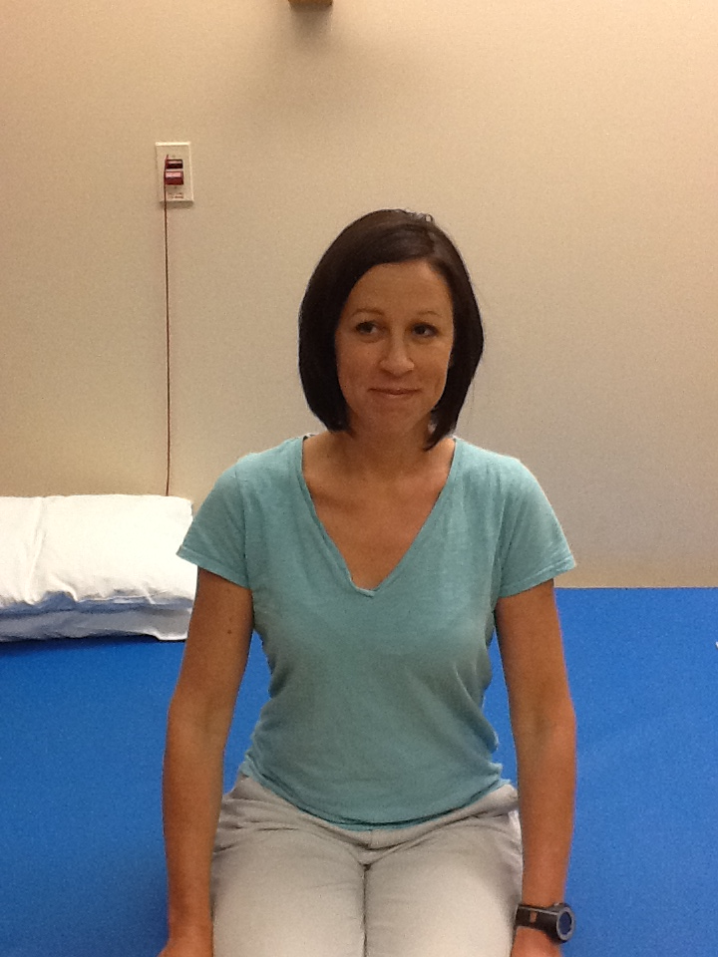
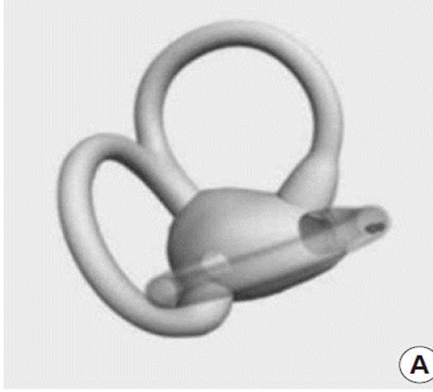
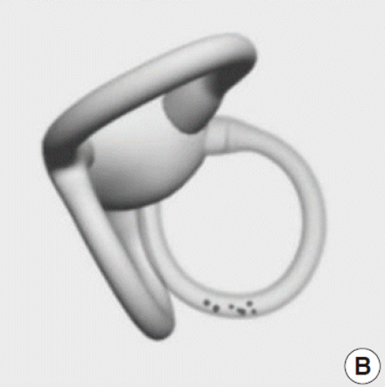
ceemjournal.org

Slide 51
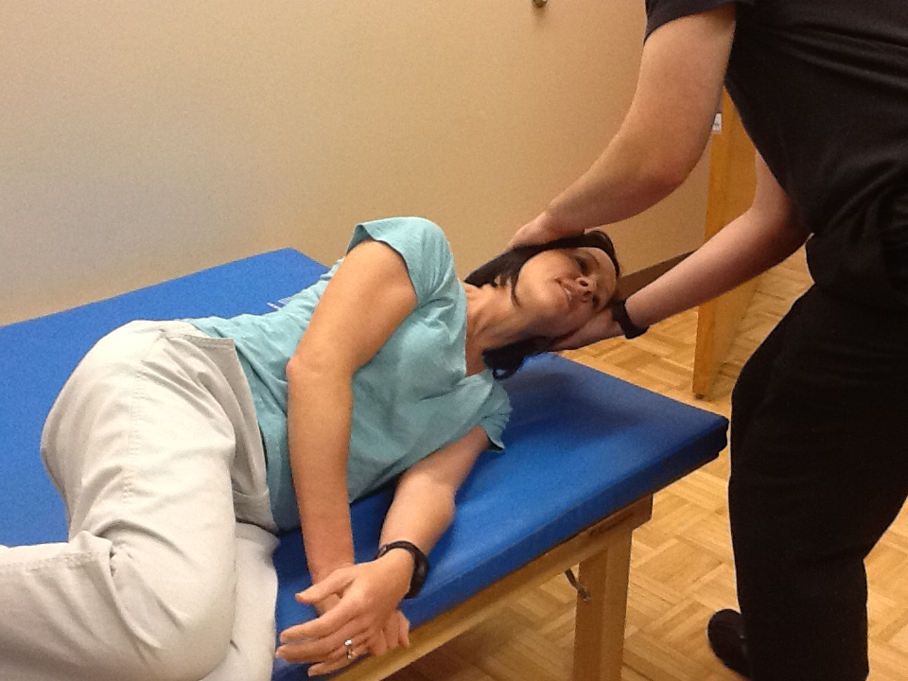
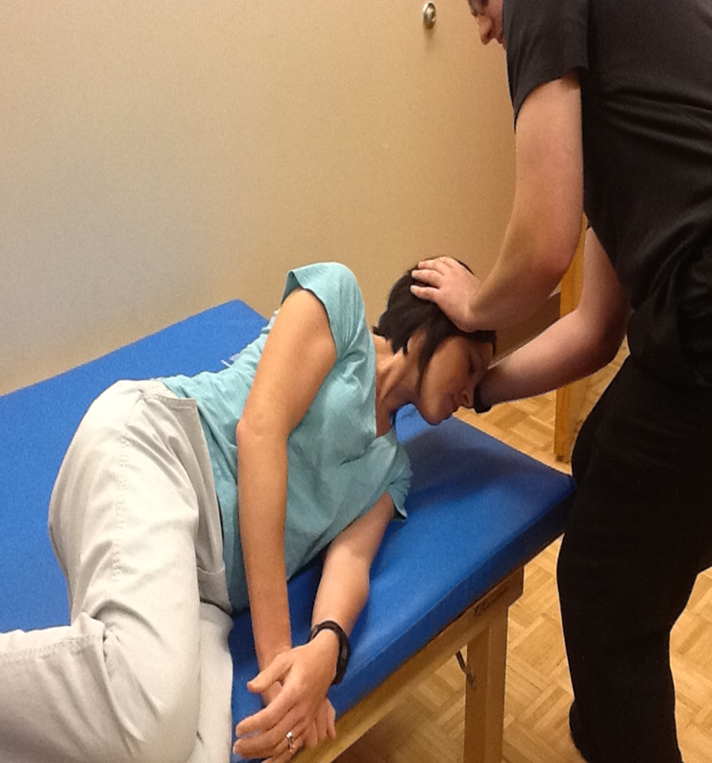
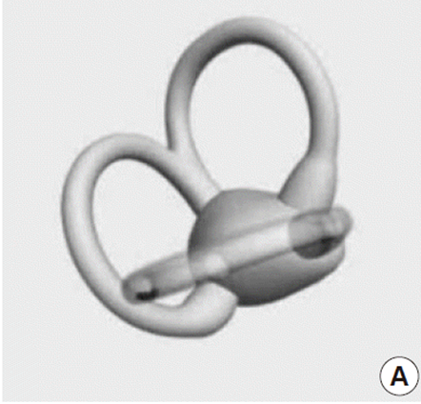
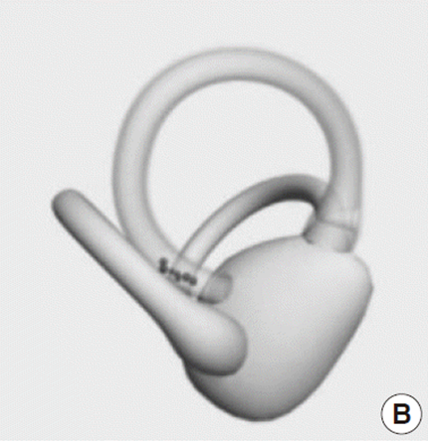
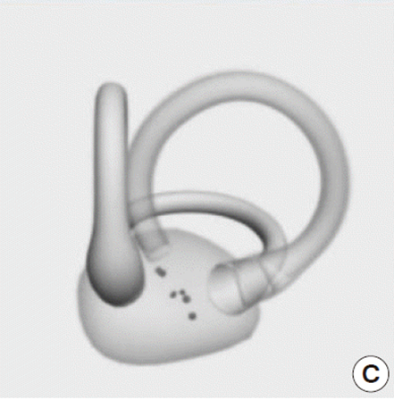

Slide 52
The patient’s emesis associated with getting in and out of bed with nursing staff (and associated nystagmus/abnormal eye movements) were resolved in 2 treatment sessions
The potential to not only influence a persons rehabilitation, but ultimately, their entire quality of life utilizing this knowledge is very profound

Slide 53
Other Common Peripheral Vestibular Problems Associated with Brain Injury
Stroke: Damage to vestibular relay nerve from diminished blood resulting in loss of vestibular information from one inner ear
Acoustic neuroma: tumor growth on or adjacent to vestibular nerve; removal of tumor eliminates vestibular input on involved side
You now have an imbalance of tonic vestibular activity: meaning even initially at rest, there is constant perception of movement
Once the brain adapts, you no longer have symptoms at rest: but now have an issue with gaze stability/visual acuity

Slide 54
Central Vestibular Disorders
Traumatic concussion or resulting neural cell death from trauma
This presenting with associated TBI neurological deficits: higher complexity and different recovery process than non-TBI
Damage of central pathways or structures discussed from vascular disruption (stroke)
Brain cancer/oncology: tumor resection involving central areas

Slide 55
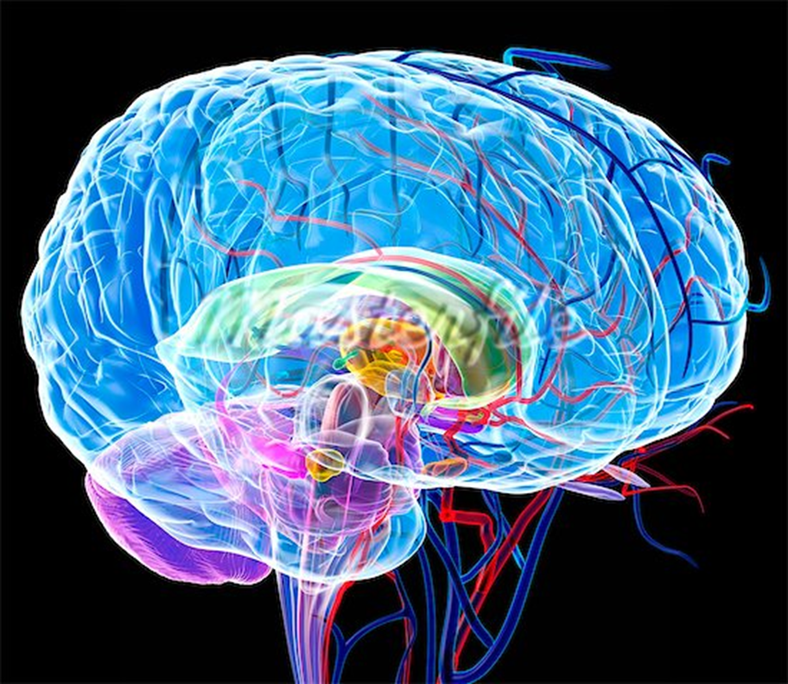
Rehabilitation and Neuroplasticity in Central Disorders Why there is great potential
“If the facts don’t fit the theory, change the facts”
Albert Einstein
img.ibxk.com.br/materias/13736/586565.jpg

Slide 56
Vestibular Adaptation
With impaired VOR as the result of brain injury: the gain of the vestibular reflex will not quite be 1: meaning that the degree of eye movement to head movement no longer matches
This may result in the visual and vestibular problems we have discussed involving vertigo and oscillopsia related to movement

Slide 57
Vestibular Adaptation
However; the vestibular system (and brain) is remarkably plastic: tapping into this neuroplasticity and restoring a normalized gain of the vestibular system, is the ultimate goal of rehabilitation
This plasticity is driven by sensory experience
In order to learn: we must be allowed to experience mistakes. In that learning process, the brain will adapt; versus maladaptive plasticity

Slide 58
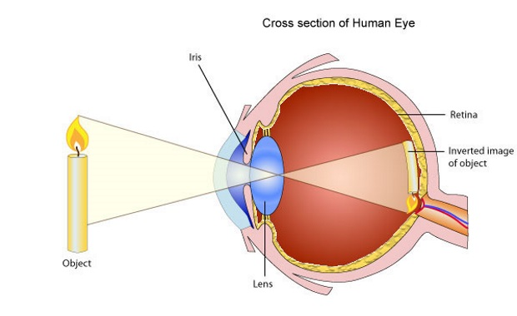
Vestibular Adaptation
With an impaired VOR: every time one practices visual fixation with a head turn, the image of that target will slip on the eye’s retina (versus normally remaining stable)
mentalfloss.com

Slide 59
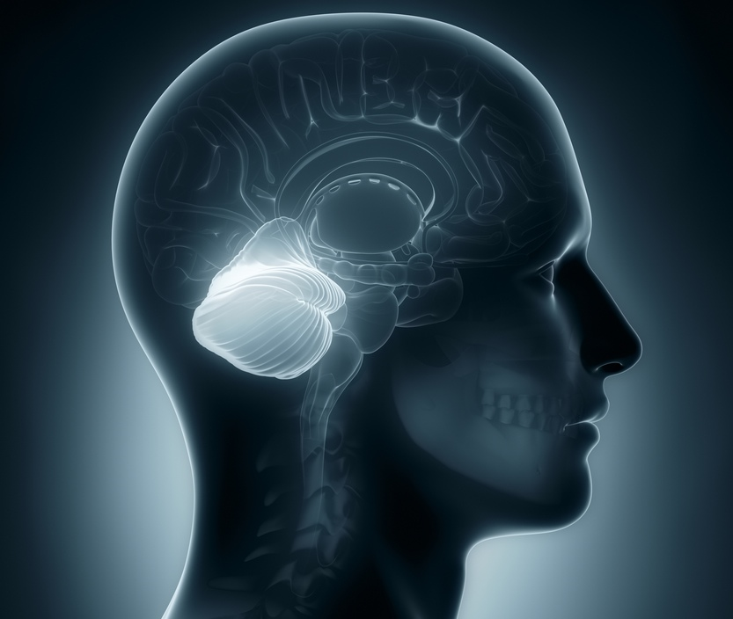
Vestibular Adaptation
In addition to vertigo, this “retinal slip” creates in error message in the cerebellum which regulates the gain of the VOR
In excess: this misinformation can make a person extremely sick, and ultimately take away their desire to move (maladaptive neuroplasticity)
www.livescience.com

Slide 60
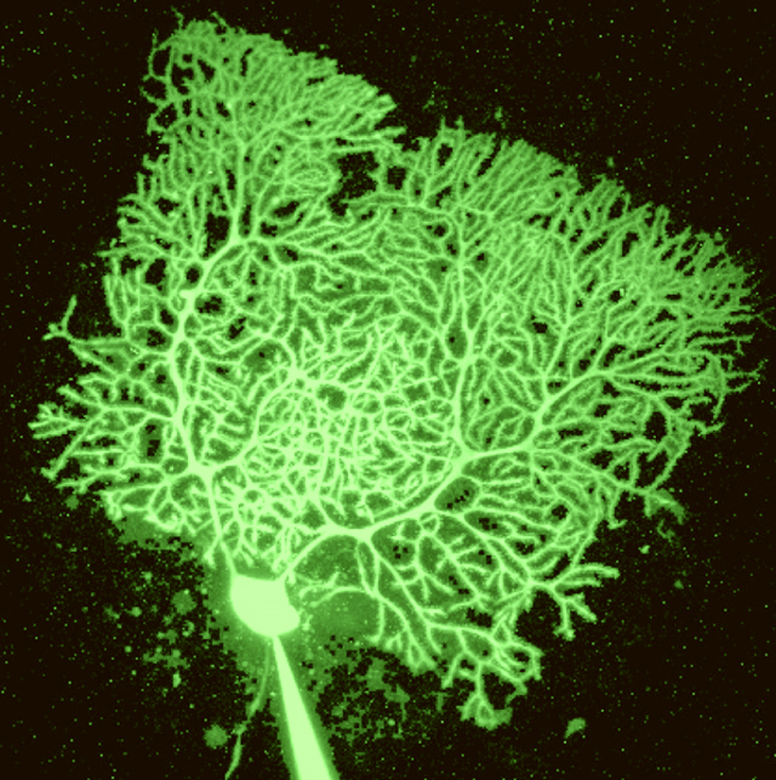
Vestibular Adaptation
However in graded amounts: this symptomatic response allows the cerebellum to recalibrate the VOR and substantially restore gaze stability and clarity of vision with head and body movement
This is where exercise prescription comes into play: to facilitate spontaneous recovery
wadem.edublogs.org

Slide 61
Vestibular Adaptation Exercises
Each brain injured person is different and unique: this requires an individualized rehabilitation program not a protocol
Many factors associated with brain injury including vision and cognition must be accommodated for
A vestibular specialist may design an exercise program to facilitate this vestibular adaptation

Slide 62
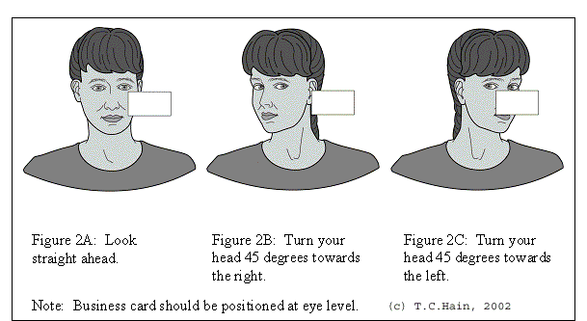
Vestibular Adaptation Exercises
The exercise below is called VOR X1: it involves re-training the VOR: by increasing symptoms in graded amounts, over time, the VOR will become faster and elicit lesser severity of symptoms
The patient uses a business card, and gently turns the head back and forth while focusing their gaze
www.dizziness-and-balance.com

Slide 63
Vestibular Adaptation Exercises
This exercise will be repeated preferably up to 3 times daily to allow for adequate vestibular adaptation
Initially someone very impaired may only be able to tolerate up to 10-15 seconds; but the long term goal is up to 1-2 minutes duration
www.dizziness-and-balance.com

Slide 64
Vestibular Adaptation Exercises
It is important to note that the VOR is context specific: this is a progression and training program that requires skill, education, and initial supervision
Gains in rehabilitation will be specific to factors as body/head position, speed of exercise, direction of exercise, use of glasses, even environmental factors such as lighting will affect vestibular response

Slide 65
Vestibular Adaptation Exercises
Initially I will train patients to become independent in seated VOR re-training; this is progressed to standing; and ultimately walking and dynamic movement required to re-integrate into community settings

Slide 66
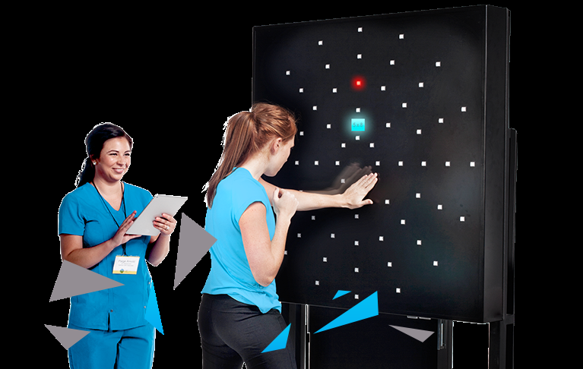
Vestibular Adaptation Exercises
More advanced exercises will begin to incorporate hand-eye coordination
Conservatively at least 3-4 weeks will be required to begin observing long term changes with higher degrees of impairment
www.dynavisioninternational.com

Slide 67
Vestibular Compensation Exercises
Involves training the substitution of quick eye movements called saccades to compensate for loss of the VOR
For example looking at a light switch: my head remains still, I quickly move my eyes towards a target, and then the head follows (versus head and eyes moving naturally in coordination)

Slide 68
Vestibular Compensation Exercises
Learning this pattern of eye followed by head movement: allows an individual to bypass the VOR; and with dynamic activity, avoid compromising situations
Initially this requires great concentration: however with practice, this strategy may become a subconscious skill: motor learning

Slide 69
Vestibular Habituation Exercises
Involves graded amounts of a noxious stimulus (which will be different for each individual) and this will become a training exercise
With repetition the severity of symptom response will become much less
Can become very creative with these exercises: including use of virtual reality, and optokinetic stimulation strategies involving visual perception of movement with a stationary body

Slide 70
Educational Resources and Advocacy Vestibular Disorders Association
Tremendous resource and advocacy organization
vestibular.org
Patient education materials: on vision, cognition, different types and treatments of vestibular disorders, and a number of other topics such as how diet and stress can influence a vestibular disorder
It also has a information for patients such as how to find a vestibular specialist in their area, local support groups, and even research participation opportunities

Slide 71
References:
1. Herdman SJ. Vestibular Rehabilitation. 3rd ed. Philadelphia, PA: FA Davis Company; 2007.
2. Bhattacharyya N, Baugh RF, Orvidas L, et al. Guidelines: clinical practice guideline: benign paroxysmal positional vertigo. Otolaryngol Head Neck Surg. 2008; 139(5S4): S47-S81.
3. Kerrigan MA, Costigan MF, Blatt KJ, Mathiason MA, Domroese ME. Prevalence of benign paroxysmal positional vertigo in the young adult population. PM&R. 2013; 5(9): 778-785.
4. Oghalai JS, Manolidis S, Barth JL, Stewart MG, Jenkins HA. Unrecognized benign paroxysmal positional vertigo in elderly patients. Otolaryngol Head Neck Surg. 2000; 122(5): 630-634.
5. Motin M, Keren O, Groswasser Z, Gordon CR. Benign paroxysmal positional vertigo as the cause of dizziness in patients after severe traumatic brain injury: diagnosis and treatment. Brain Injury. 2005; 19(9): 693-697.
6. Zasler ND, Katz DI, Zafonte RD. Brain Injury Medicine; Principles and Practice. 2nd ed. New York: Demost Medical Publishing; 2013.
7. Lui H. Presentation and outcome of post-traumatic benign paroxysmal positional vertigo. Acta Otolaryngol. 2012; 132(8): 803-806.
8. Katsarkas A. Benign paroxysmal positional vertigo (BPPV): Idiopathic versus post-traumatic. Acta Oto-Laryngologica. 1999; 119(7): 745-749.

Slide 72
References:
9. Fife TD, Giza C. Posttraumatic vertigo and dizziness. Semin Neurol. 2013; 33(3): 238-243.
10. Leigh, RJ, Zee DS. The Neurology of Eye Movements. 4th ed. Oxford, NY: Oxford University Press, Inc.; 2006.
12. Appiani C, Catania G, Gagliardi M, Cuiuli G. Repositioning maneuver for the treatment of the apogeotropic variant of horizontal canal benign paroxysmal positional vertigo. Otol Neurotol. 2005; 26(2): 257-260.
13. Asprella-Libonati G. Benign Paroxysmal Positional Vertigo and Positional Vertigo Variants. Int J Otorhinolaryngol Clin. 2012; 4(1): 25-40.
15. Hain, Timothy. (2015, February 15). Lateral Canal BPPV. Retrieved from http://www.dizziness-and-balance.com/disorders/bppv/lcanalbppv.htm.
16. Vestibular Disorders Association: vestibular.org
17. Images cited on individual slides
18. Gurvich C, Maller JJ, Lithgow B, Haghgooie S, Kulkarni J. Vestibular insights into cognition and psychiatry. Brain Res. 2013; 1537:244-259.

