Slide 1
Eye Movements and Biomarkers
Development of a Multi-Modal CLASSIFICATION SCHEME FOR Brain Injury
Vikalpa Dammavalam, BS, Senior Project Coordinator
Sam Daly, BA, Research Assistant

Slide 2
Disclosure Policy
It is the policy of Hennepin County Medical Center to ensure balance, independence, objectivity and scientific rigor in all its sponsored educational activities. All faculty participating in sponsored programs are expected to disclose to the audience any real or apparent conflicts of interest to the content of their presentation. Our speaker has indicated that they have financial relationships to disclose related to this presentation.

Slide 3
How dangerous are sports?
Activity | Deaths
Riding in car | 144 deaths per million
Equestrian | 20 deaths per million
Biking, snowboarding, skateboarding, skiing | 15 deaths per million
Football, playground activities | <10 deaths per million
Swimming | 140 pediatric deaths per year (confounded denominator)

Slide 4
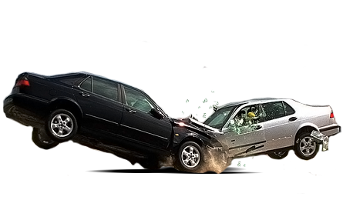
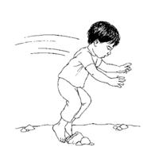
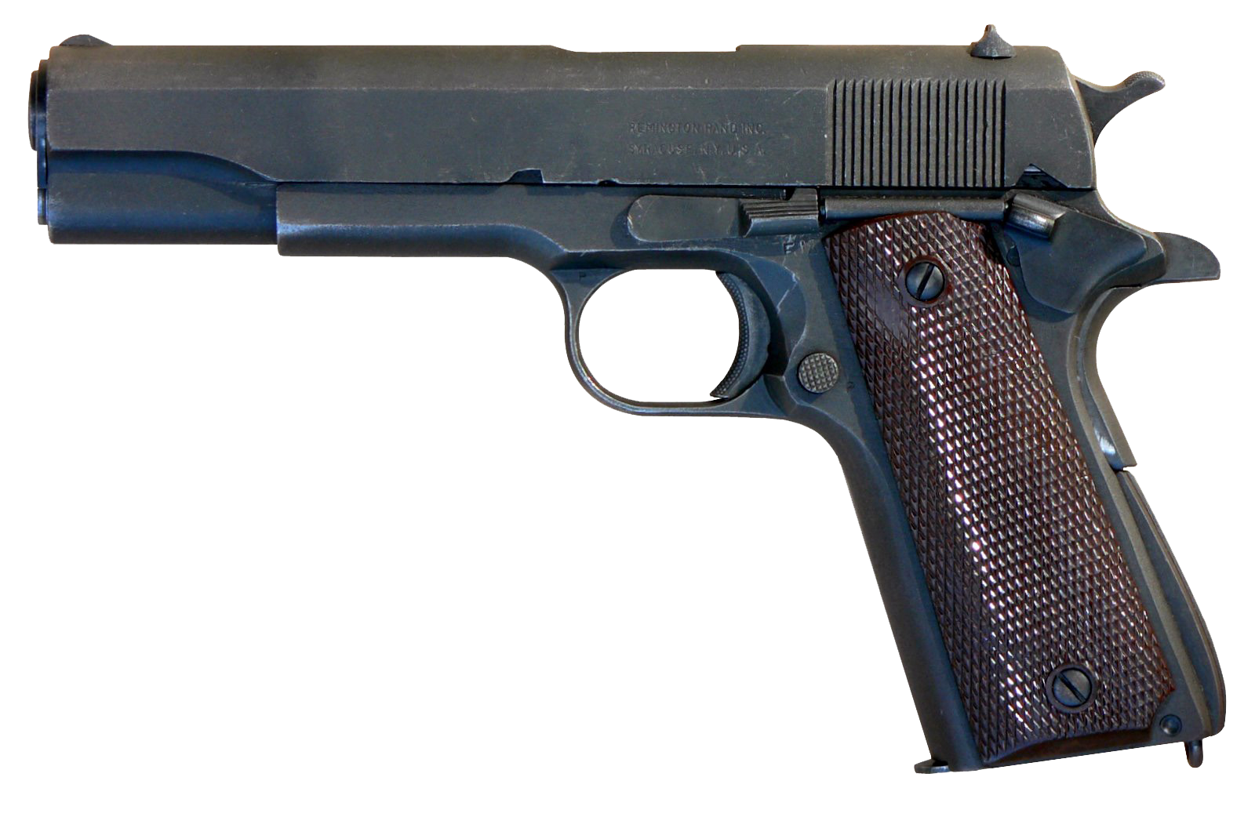
What causes brain injury?
In kids: accidents, homicide, suicide
11 American teens die every day texting and driving
½ of all brain trauma occurs in intoxicated people
Notes:
According to the CDC, falls are the most common cause of TBI followed by being struck by or against an object and MVA. Falls disproportionately affect the youngest and oldest demographics. In pediatric populations, falls are most likely sports related.
While death is a rare event in sports, the recent reports of CTE in former NFL players has many people worried that brain injury in adolescence will cause dementia later.
The majority of people with dementia do not have a history of brain injury, and the majority of people with brain injury do not become demented³³.

Slide 5
Why is concussion/brain injury so hard to diagnose and define?
The brain is not simple.
No two brains are the same.
No one brain is the same over time.
Children learning to read activate different areas for speech as they progress…
Monzalvo et al. Brain and Language, Volume 127, Issue 3, 2013, 356 - 365

Slide 6
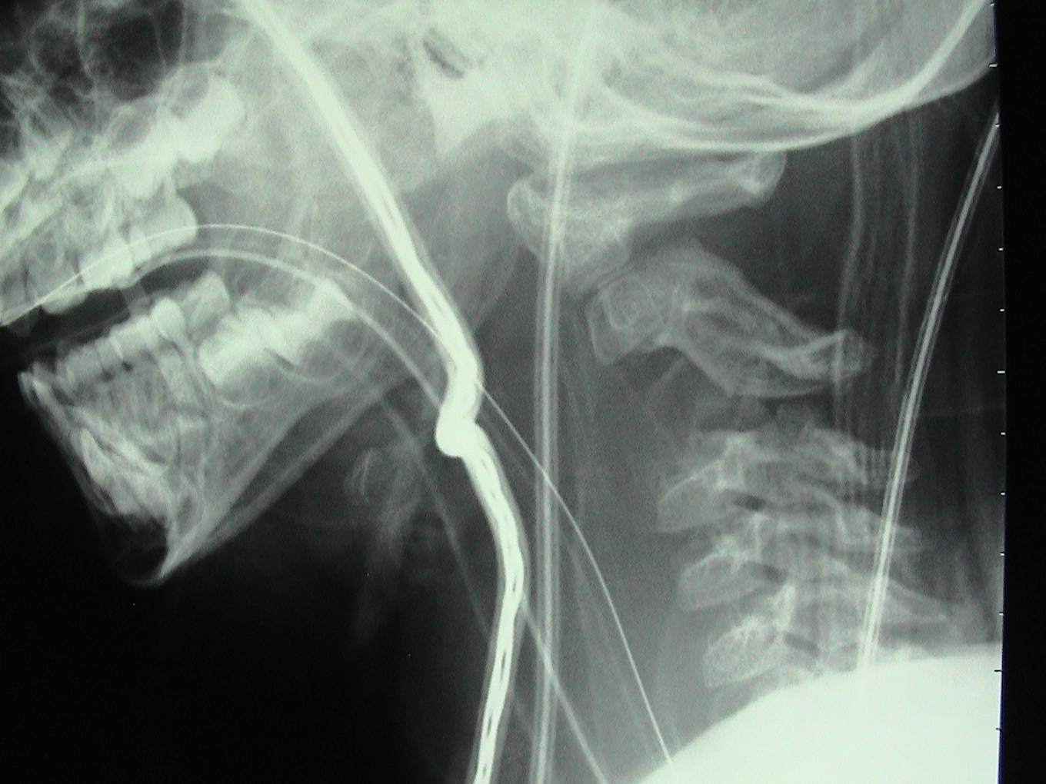
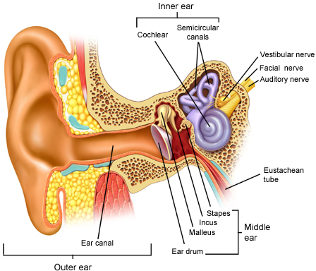
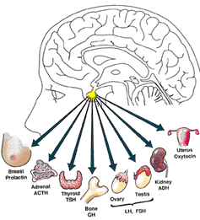
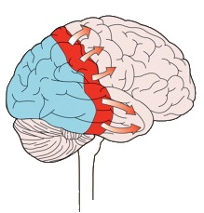
Why is concussion/brain injury so hard to diagnose and define?
No two brain injuries are the same! Similar symptoms can have multiple causes
Prognosis
Best
Scalp Injury
Skull Injury
Compressive Lesions
Epidural / Subdural
Subarachnoid Hemorrhage/IVH
Diffuse Axonal Injury
Anoxic Brain Injury
Neck Injury
Inner Ear Injury
Endocrine Dysfunction
Cortical Spreading Depression
Worst

Slide 7
Why is concussion/brain injury so hard to diagnose and define?
Some people with brain injury were never “hit” in the head.
Primary blast injury: transmission of the blast pressure wave to the brain.
Secondary blast injury: penetration of projectiles through the skull and into the brain.
Tertiary blast injury: acceleration and deceleration effects, for example, if the casualty is thrown against fixed surfaces.
Quaternary blast injury: thermal, chemical, and other injuries to the head, including the face, scalp, and respiratory tract.
Schematic diagram of the mechanisms of blast-related traumatic brain injury. Figure shows local effects (1–7) and systemic effects (8, 9) of primary blast injury, secondary blast injury (10–12), tertiary blast injury (13), quaternary blast injury (14), and portals for blast wave transmission to the brain (15, 16). (1) Acoustic impedance mismatch causes spallation. (2) Shock–bubble interaction. (3) Shear stress causing diffuse axonal injury. (4) Cavitation. (5) Skull deformation with elastic rebound. (6) Reflection of the blast wave within the skull. (7) Bobblehead effect of acceleration–deceleration. (8) Blood surge from the torso damages the microvasculature. (9) Air embolism from blast lung injury.(10) Penetrating fragments. (11) Compound fractured skull. (12) Intracerebral haemorrhage. (13) Contrecoup contusion. (14) Burns. (15) Blast wave transmitted through the orbits. (16) Blast wave transmitted through the nasal sinuses. Rosenfeld et al. Lancet Neurology Blast-related traumatic brain injury, 2013-09-01Z, Volume 12, Issue 9, Pages 882-893

Slide 8
Why is concussion/brain injury so hard to diagnose and define? No two recoveries are the same (functional plasticity, resilience)

Slide 9
The Three Major Types of Brain injury
Mild Moderate Severe
GCS 13-15 GCS 8 -13 GCS<8
Amnesia<30 min amnesia >30 min <7d amnesia>7d
short LOC middle LOC long LOC
Most commonly used definitions/classification schemes for brain injury are confusing.
Loss of consciousness can occur for many reasons! (intoxication, polytrauma)
Lack of LOC does not equate with milder injury (either short or long term)
37 yo woman who fell 2 weeks prior and had a SDH – She was GCS 15 and went to the OR two weeks after the fall.

Slide 10
Why is concussion/brain injury so hard to diagnose and define? Neither imaging nor LOC tell the whole story
Physiologic
TBI
Structural TBI
Loss of
consciousness

Slide 11
What are the long term consequences of brain injury?
Prognosis
Best
Scalp Injury
Skull Injury
Compressive Lesions
Epidural / Subdural
Subarachnoid Hemorrhage/IVH
Diffuse Axonal Injury = CTE/affective changes/suicide
Anoxic Brain Injury =
Permanent Neuro Deficit
Spinal Cord Injury = Paralysis
Inner Ear Injury = Dizziness
Endocrine Dysfunction=
Depression, Suicidality
Cortical Spreading Depression =
Headache, Seizures, Stroke
Worst

Slide 12
Suicide in the general population and NCAA athletes
Published Oct 2015
Among Males:
Anesthesiologists 19 per 100,000
General Population 12 per 100,000
College Students 9 per 100,000
NCAA Football Players 2.25 per 100,000
NCAA Athletes 0.93 per 100,000

Slide 13
What is Chronic Traumatic Encephalopathy (CTE)
First discovered in 1928 in NJ boxers published in JAMA
Found in 17% of living professional boxers in England, named CTE in 1969
Motor deficits, Dementia
Pathology described in 1960’s and 1970’s at Queen’s Square, England

Slide 14
new definitions for CTE in the 2000’s
Omalu et al and McKee et al.

Slide 15
“CTE, as defined in America, is not a neurological entity, but is a culture-specific social phenomenon.”
Jim Andrikopoulos, British Medical Journal

Slide 16
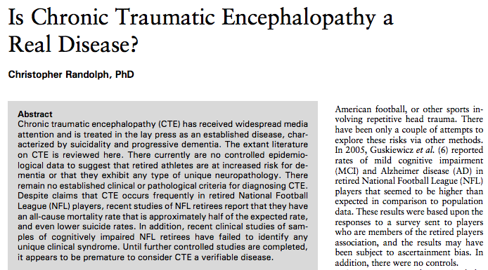
Current Sports Medicine Reports
January/February 2014 - Volume 13 - Issue 1 - p 33–37

Slide 17
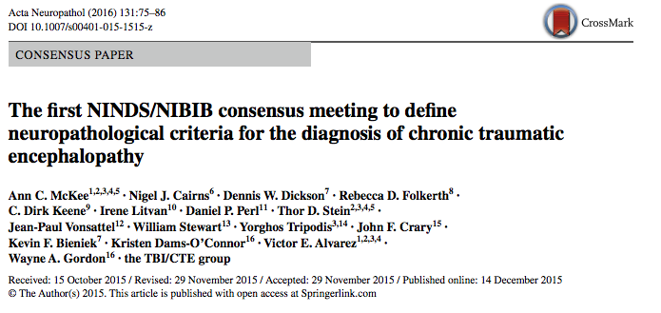
the first two are clinically asymptomatic
February 2015: The feds step in to help define CTE → decide on 4 types

Slide 18
CTE is equally common in people with and without clinical neurodegenerative symptoms
CTE prevalence in people with neurodegenerative diseases (11.8%) was the same as in controls (12.8%).
Patients with CTE died at a mean age of 81 years and that “most positive cases [were] likely to be clinically asymptomatic.”
CTE is found under the microscope in equal proportions of healthy normal asymptomatic people as it is in people with dementia and other diseases.
Notes:
In that same journal of Acta Neuropathologica where the Mayo Clinic study appeared, a second paper by Ling et al. was published by a group of pathologists at Queens Square. It compared the brains of people who died with neurodegenerative diseases to control subjects.
The most recent Queens Square study found CTE in 12.8% of normal controls, while an NIH funded committee first met to define the condition, based on 25 total known cases on February 2015. It has been argued that the microscopic findings of CTE are actually due to genetic mutations, drugs such as the opiates (painkillers) that are frequently taken by football players, normal aging, environmental factors, brain processing during autopsy, and toxins.
This raises questions regarding the significance of the pathologic findings seen under the microscope.

Slide 19
Contact sport athletes, regardless of injury, are at increased risk for “symptomless” CTE
CTE pathology in 21/66 former athletes; 3 had prior concussions.
CTE not seen in 198 non-athletes, of whom 33 had documented head trauma.
There was no association between clinical symptoms and CTE
Notes:
The paper by Bienick was a study of male brain donors who died in their mid-70’s and had developed neurodegenerative disorders in their late 60’s. The investigators determined whether the study subjects had been exposed to contact sports by looking at their medical records and searching online through their obituaries.
66 men were thought to have participated in contact sports and 198 non-participants were also identified. There was no difference in age with regards to the onset of neurodegenerative symptoms between the groups.
The paper states “Among those exposed to contact sports, those with CTE pathology did not differ from those without CTE pathology with respect to noted clinicopathologic features.” In other words, the people who had abnormal brain tangles under the microscope had no symptoms in real life that were different from those who did not have brain tangles. The “CTE” patients had no symptoms different from anyone else!

Slide 20
What is the Relationship Between Concussion and Dementia?
1/3 of Americans have had a concussion in their lifetime, 2/3 of these are in males
Dementia occurs about 63.5 per 1000 persons in the US32
Alzheimer’s twice as common in women vs men
5 Million have Alzheimer’s – no reliable diagnostic, unknown cause
Other common types: vascular dementia, frontotemporal dementia, normal pressure hydrocephalus

Slide 21
What are the risk factors for dementia?
High blood pressure
Diabetes
Sedentary lifestyle
High fat diet
Frequent alcohol use
Female gender
Low socioeconomic status (women)
Smoking
Atrial fibrillation
Genetics
Decreased level of education (women)
Mild brain injury if over 65 years of age (men)
Moderate or severe brain injury if over 55 (men)
Notes:
Many risk factors impact the likelihood that someone will have dementia, and brain injury is among these.
There is no epidemiological study or any Class I, II or III evidence supporting that contact sports performed at the middle school or high school level increases risk for later life dementia.

Slide 22
Does high school football increase risk for dementia?
438 Football Players followed for 50 years
Same risk for dementia as members of chorus, glee club or band
Notes:
This epidemiologic study suggests that children and young adults may be more resilient and have a longer period of time to recover from brain injury.
Class III evidence exists that playing football in high school does not increase risk for any neurodegenerative disease >50 years later¹⁹.

Slide 23
Why Do clinical trials for tbi fail?

Slide 24
Would you run a clinical trial for “chest pain” with history and exam as your classifier?
Death
Vegetative state
Lower severe disability
Upper severe disability
Lower moderate disability
Upper moderate disability
Lower good recovery
Upper good recovery
TREAT

Slide 25
General reasons clinical trials fail
Lack of Comparable Controls
Poor Retention
Limitation of Transitioning from Animal to Human Trials
Small N
No Effect of the Treatment

Slide 26
Problems with TBI trials, Specifically
Inclusion Criteria
Fails to capture diverse underlying pathology with highly variable prognoses
Outcome Measures
Fails to capture subtle improvements

Slide 27
Initial Search of 30 failed trials since 1992
Hypothermia/Temperature Control: 13
Pharmacology: 10
Surgical Intervention: 3
Hyperbaric Oxygen: 2
Hypertonic Saline: 1
ICP Monitoring: 1

Slide 28
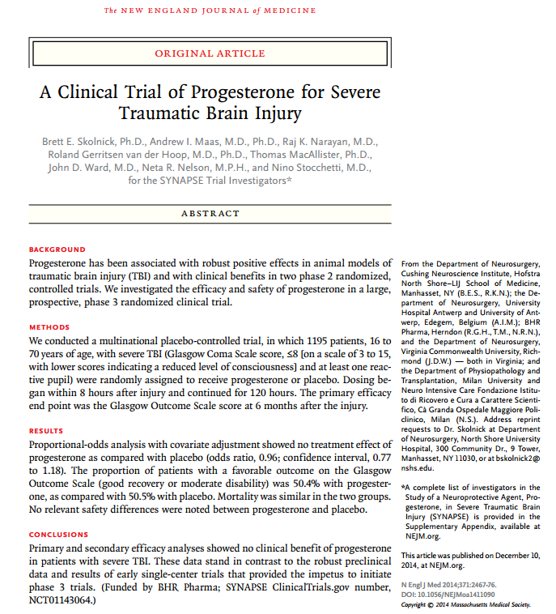
SyNAPSe Trial for Progesterone
Randomized >1000 patients with GCS 4-8
Progesterone (N = 591)
Placebo (N = 588)
96% Retention rate at 6 month end point
3 month: GOS
6 month: GOS-E
No difference between group characteristics
No difference between GOS scores at either time point

Slide 29
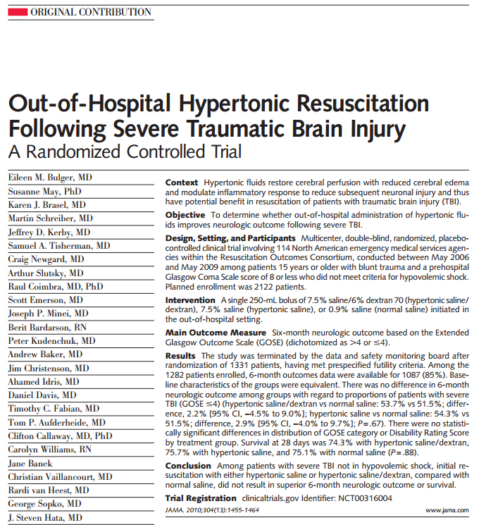
Hypertonic Saline Trial
Randomized >1000 patients GCS 3-8
HTS/Dextran
HTS
Saline
85% retention rate at 6 month end point
6 month GOS-E
6 month DRS
28 day mortality
Terminated at half the intended sample size- data futility

Slide 30
Initial Search of 30 Failed Trials since 1992
Inclusion Criteria
Outcome Measures
GCS: 20
GCS with +CT: 4
GCS Motor Score: 1
AIS Range: 1
‘Head trauma’: 2
ICP values: 1
Traumatic SDH: 1
GOS: 11
GOS as primary measure: 14
LOS, DRS, ICP, SAE’s, Neuropsych, Quality of Life, CPP, GOAT, ect.
PCPC: 1 (Pediatric GOS)
Temperature Gradient: 1
GOS as Secondary Measure
IMPACT: 1
Neurobehavioral Rating Scale: 1
Bayley-III: 1

Slide 31
Review Article
Search for clinical trials between 1975 and 12/2015
((traumatic brain injury[MeSH Terms]) AND Clinical Trial[ptyp] AND humans[Mesh] AND English[lang])
~700 of the 2046 studies were treatment trials
Revealed about 150 different treatments for acute TBI and residual symptoms
Many of them relied on measures such as the GCS and GOS

Slide 32
Brain injury assessment study at Hennepin county medical center (BASH)
Sam Daly, BA

Slide 33
goals
Establish an objective, multi-modal classification scheme for TBI based on underlying brain pathology using eye tracking, blood-based biomarker analysis, brain imaging, and standardized assessments.
Establish an outcome measure for TBI using those same methods that sensitively detects subtle improvements in pathology, cognitive ability and quality of life.

Slide 34
Screening Process
Recruit consecutive patients from the ED and trauma bay for 2 years
Isolated TBI
Isolated Body Trauma
Combined Trauma
Controls: Non-Trauma (friends and family members of patients)
Target N=9,000 for a 24 hour Screening Process
Physiologic Measure: Eye Tracking
Blood-based Biomarkers
Radiographic Measures: MRI and Clinically indicated CT
Cognitive, Neurologic, and Symptom Assessments
(CSF collection, Pathologic specimen, Brain Tissue Oxygenation data)

Slide 35
Follow-Up Assessments
Target N for Follow-up = 1,000
Assessment Battery: NOS-TBI, SCAT3, MPAI-4, GOS-E, GOAT, BAT-L, and BTACT
 | Eye Tracking | Blood Draw | 3T MRI | CT Scan | Assessment Battery (min) | Total Time
2 Weeks | X | X |  |  | 30 | 45
4 Weeks | X | X |  |  | 25 | 45
3 Months | X | X |  |  | 65 | 90
6 Months | X | X |  |  | 25 | 45
1 Year | X | X | X* | X* | 60 | 90

Slide 36
1. Create an Objective, Multimodal Classification Scheme for TBI
Initial Screening Process
Final Diagnoses
Eye tracking
Blood(/CSF)-based Biomarkers
Radiographic Imaging
Neurologic Assessment
Cognitive Assessment
Symptom Severity Assessment
Scalp Injury
Skull Injury
Neck Injury
Inner Ear Injury
Endocrine Dysfunction
Cortical Spreading Depression
Compressive Lesions
Subarachnoid/Intraventricular Hemorrhage
Diffuse Axonal Injury
Anoxic Brain Injury

Slide 37
Hypothesis Table
 | Scalp Injury | Skull Injury | Neck Injury | Inner Ear Injury | Endocrine Dysfunction | Cortical Spreading Depression | Compressive Lesions (EDH/SDH) | SAH/IVH | Diffuse Axonal Injury | Anoxic Brain Injury
Eye Tracking | Normal | Normal | Normal | May or May Not be Normal | Normal | Abnormal BOX score | Abnormal Aspect Ratio | Abnormal BOX score | Abnormal BOX score | Abnormal BOX score
Proteomic Markers | +/- Markers of Inflammation; +/- Markers of Coagulation; +Caspase | + Markers of Inflammation; + S100B; +Caspase | +/- Markers of Inflammation; +Caspase; +NGF | TBI-Specific markers unlikely to be +/- | +Cortisol; -Growth Hormone; Less than 50% will have hypopituitarism | +Glu; -Glu receptor Antibodies; +APOE | +GFAP; +/-S100, +Aldosterone | +GFAP; +S100B; +MMP-9; +cFn; +BNP; +CRP; +Copeptin; +Adhesion molecules; +Caspase-3; +NSE | +S100B; +NSE; +p- tau | +S100B: +MBP; +NSE; +GM-CSF; +INF-gamma; TNF; +tau; +GFAP; +pNF-H; +UCHL1
Imaging | Extracranial soft tissue changes on CT or MRI | Fractures are likely visible | CT or MRI may demonstrate abnormality | Likely normal; May see tectorial membrane injury | Not generally visible | Not visible | Visible on CT and MRI | Visible on CT and MRI | Sometimes visible with DTI, SWI, DWI, FLAIR, T2*, CT, White matter (1)H-MRS | DTI, CT (tissue density)
Expected Outcomes | All tests at baseline within 1 week | All tests at baseline within several weeks | Variable outcomes on all tests | Return to baseline possible on all tests | Increased: SSS Reduced: SAC, NOS-TBI, QoL Variable: GOS, Amnesia | Unknown | Return to baseline possible on all tests | Increased: SSS Reduced: SAC, NOS-TBI, QoL Variable: GOS | Increased: SSS Reduced: SAC, NOS-TBI, QoL Variable: GOS, Amnesia | Increased: SSS Reduced: SAC, NOS-TBI, QoL Variable: GOS

Slide 38
2. Establish and Validate a Sensitive Outcome Assessment for TBI
Objective Measures
Outcome Assessments
Eye Tracking
Blood-based Biomarkers
Proteomic Analysis
Genomic Analysis
Radiographic Imaging
Clinical Course
Adverse Events
Neurologic Functioning
NOS-TBI
Cognitive Functioning
SCAT3 (SSS and SAC)
Quality of Life
Quality of Life After TBI

Slide 39
Significance
Increased validity in testing novel therapeutics and prophylactics.
Stratify patients into homogenous experimental groups
Utilize sensitive outcome measures
Develop novel therapeutics and prophylactics
Understanding more about underlying pathology
Advance eye tracking technology
Safe, non-invasive, quick assessment

Slide 40
Blood-based biomarkers for tbi

Slide 41
Biomarkers Specific to brain injury
Neuronal Injury
Neuron Specific Enolase (NSE)- Neuron-specific isoform of the glycolytic enzyme Enolase
Ubiquitin C-terminal Hydrolase (UCTHL-1)- Cytoplasmic protease that used to be used as a histological marker of neurons
Axonal Injury
Myelin Basic Protein (MBP)- Major component of CNS myelin sheath
Tau Protein- Forms microtubule bundles in axons
Glial Injury
S100B- low-affinity calcium-binding protein found in astrocytes
Glial Fibrillary Acidic Protein (GFAP)- concentrated in cytoskeleton of astrocytes
Notes:
End up in the peripheral blood stream after both cell death and BBB disruption

Slide 42
Biomarkers Not Specific to brain injury
Inflammatory Markers
Ex. Interleukin Cytokines, Tumor Necrosis Factor
Oxidative Stress
Ex. Amyloid Beta, F2-Isoprostane, Heat Shock Proteins
Pituitary Dysfunction
Ex. Progesterone, Cortisol
Coagulation Markers
Ex. Vascular Endothelial Growth Factor, Thrombomodulin
Metabolitic Dysfunction
Ex. Lactate, Pyruvate
Auto-antibodies
Specific Markers- S100B, GFAP, Glutamate

Slide 43
Our results
Biomarker | Diagnosis | Time Point
 |  | Day of Admission |  |  | 2 Weeks | 4 Weeks | 3 Months | 6 Months | 1 Year
 |  | ADM | 3-6 Hours | 24 Hours
GFAP | Scalp Injury
 | Skull Injury
 | Neck Injury
 | Inner Ear Injury
 | Endocrine Dysfunction
 | Cortical Spreading Depression
 | Compressive Lesions
 | SAH/IVH
 | Diffuse Axonal Injury
 | Anoxic Brain Injury

Slide 44
eye tracking
Vikalpa Dammavalam, BS

Slide 45
eye movement control involves many parts of the Brain
Separate nuclei within the brainstem are responsible for vertical vs horizontal eye movements. In fact the vertical component has separate nuclei regulating upward vs downward.
Most of this pathway is not under our volitional control. When our eyes are moving they move together not because we want them to but because they are wired to do that automatically.
A supranuclear disruption to this pathway will most likely affect both eyes. Lesions occurring further away from the nucleus, affecting a cranial nerve or the eye itself, are the most likely causes of motility disorders affecting only one eye.
Horizontal Gaze
PPRF
Vertical Gaze
Posterior commisure
riMLF
Notes:
Before I begin showing data, I’d like to mention a few components of the pathways involved in the control of smooth pursuit eye movements.
What we take from this, is that the eye tracking will be detecting eye movements that are automatic. It will detect when the eyes are not moving together on a biological level to showcase abnormalities in neural pathways.

Slide 46
Eye Tracker
Non-invasive – as simple as watching television
Portable or stationary set up
Takes 15 minutes start to finish with SCAT3
Anyone can be tracked, irrespective of age, gender, race and education level.
Immediate quantitative results
Notes:
There are no risks associated with our device.
It is designed to be easy to administer and easy to participate.
The set up you see here is our portable tracker. There is a monitor attached to a movable arm that we can adjust to reach patients in their bed at various angles. The other two moniters are for running MatLab and the Eyelink camera.
The two most popular videos we currently use are Puss in Boots and Lion King. They are 220 seconds long and move cyclically around the screen 5 times.

Slide 47
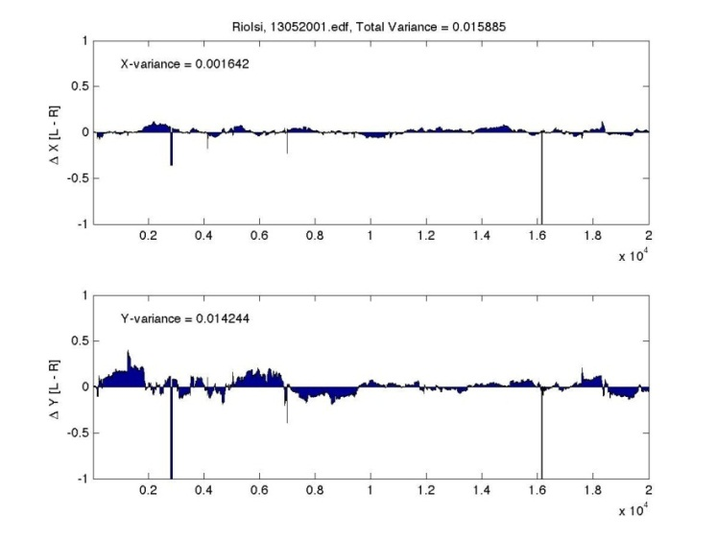
Binocular Tracking of Normal Subject
Left Eye
Right Eye
Conjugacy
.
total var.015885

Slide 48
Cranial Nerve iii Severed
Left Eye
Right Eye

Slide 49
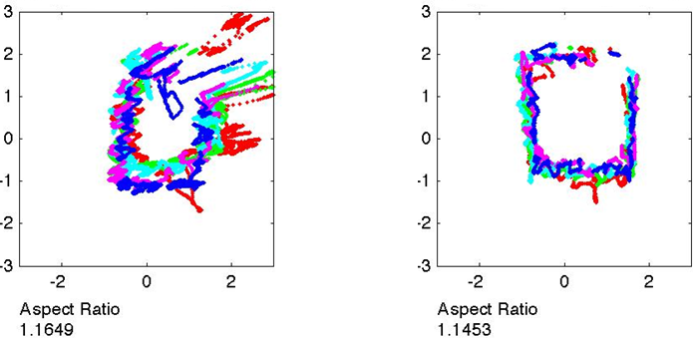
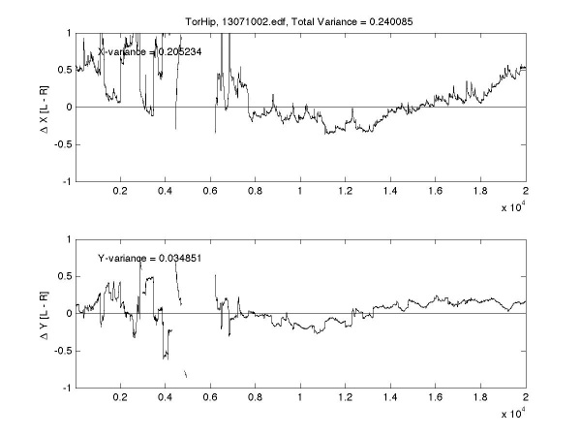
Cranial Never VI Palsy
Left Eye
Right Eye
Conjugacy
Postoperative resection of a petrous meningioma

Slide 50
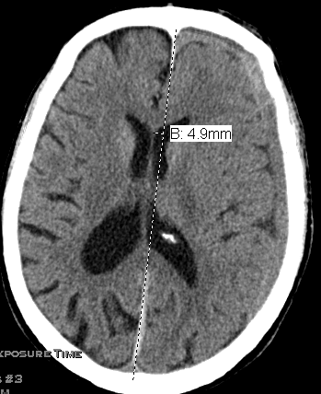
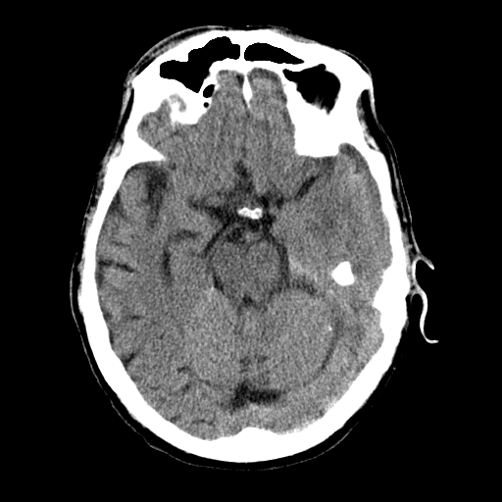
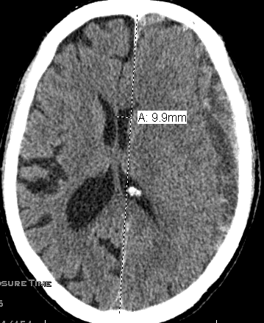
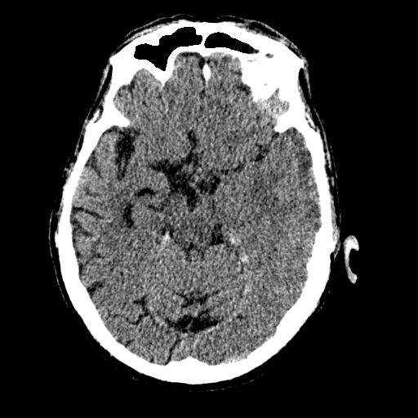
Supratentorial Mass lesion – CN III Palsy
Hypertension, hyperlipidemia mild chronic renal insufficiency, ophthalmologic history of bilateral cataract surgery (2 years and 8 years prior), pseudophakia and scleral buckling. He had a baseline visual acuity of 20/25 (right eye) and 20/30 (left eye)
Left Eye
Right Eye
At presentation
Complaining of
a headache
8 days later
Headache
resolved but
recurred
86 y/o male subdural hematoma

Slide 51
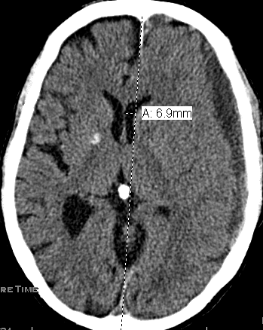
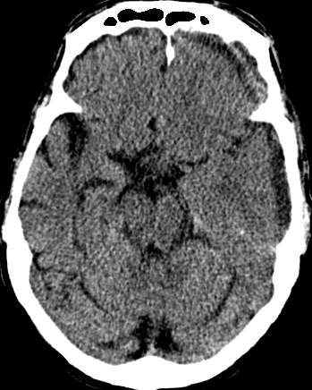
Supratentorial Mass lesion – CN III PAlsy
Hypertension, hyperlipidemia mild chronic renal insufficiency, ophthalmologic history of bilateral cataract surgery (2 years and 8 years prior), pseudophakia and scleral buckling. He had a baseline visual acuity of 20/25 (right eye) and 20/30 (left eye)
Left Eye
Right Eye
After 100 cc of subdural hematoma was evacuated
86 y/o male subdural hematoma

Slide 52
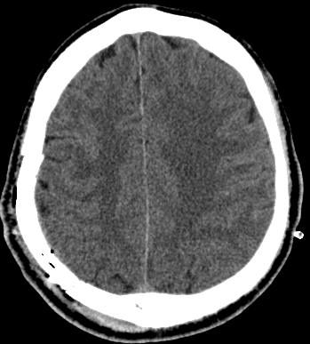
Supratentorial Mass lesion – CN VI Palsy
Left Eye
Right Eye
Preop
7 days
Postop
63 y/o male with epidural hematoma preoperative

Slide 53
Supratentorial Mass lesion – CN VI Palsy
Left Eye
Right Eye
Left Eye
Right Eye
11 days postop
35 days postop
The subject returned to work 2 months after the ictus, and has not been eye tracked again.
63 y/o male with epidural hematoma postoperative

Slide 54
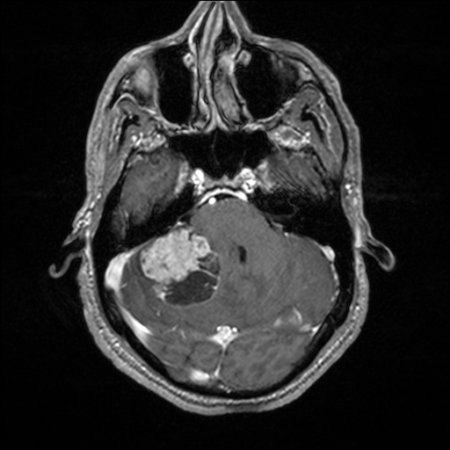
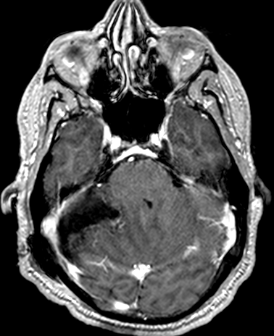
Infratentorial Mass Lesions – CN VI Palsy
Left Eye
Right Eye
Preop
56 y/o male with lung mass, headaches; Ophthalmology: no evidence of papilledema.
Aspect Ratio 1.03
Aspect Ratio 1.44
Postop Day 1
Aspect Ratio 0.97
Aspect Ratio 1.02

Slide 55
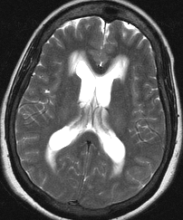
Hydrocephalus – CN VI Palsy
Left Eye
Right Eye
59 y/o female one year history of progressive intermittent vertigo, biparietal headache and
imbalance. She reported intermittent horizontal diplopia. Ophthalmologic examination revealed full ocular motility, and no evidence of papilledema or neurosarcoidosis.
CSF ACE1 level was 4.8 U/l (reference range 0 to 2.5 U/l) and biopsy of a pulmonary mass revealed sarcoidosis.
Aspect Ratio 0.81
Aspect Ratio 1.34
Aspect Ratio 1.04
Aspect Ratio 1.00

Slide 56
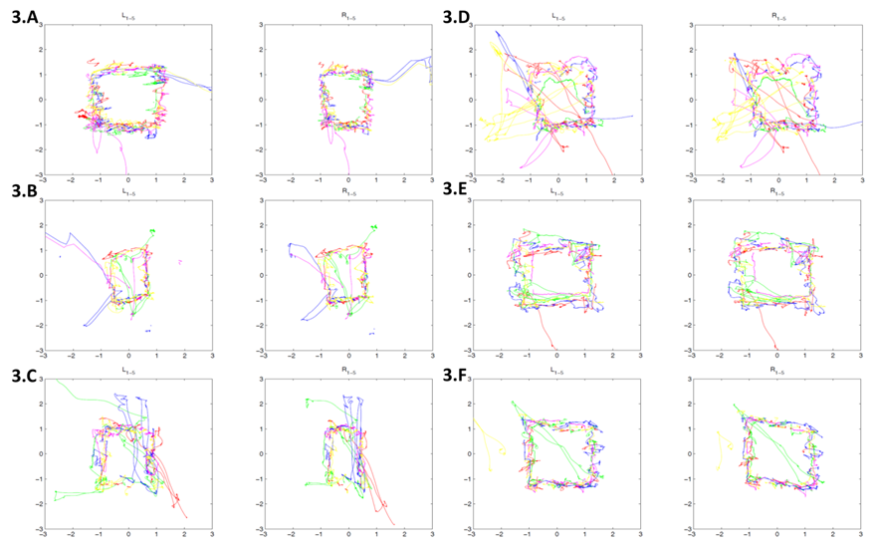
Elevated Intracranial Pressure – CN VI Palsy
Before Surgical Intervention
ICP 10
ICP 30
ICP 9
ICP 18
EVD removed
37 y/o male with pineal region tumor and obstructive hydrocephalus
Notes:
We can detect marked changes in aspect ratio in at higher ICP levels. Before neurosurgical intervention, there is a characteristic compression in the R eye box. At a presumably higher ICP of 30, we can see the compression in both eyes. As the pressure decreases, the aspect ratio seems to come closer to 1.
34 year old male with no significant medical history, presented with pineal region tumor and obstructive hydrocephalus without papilledema and secondary to acqueductal stenosis after confusion, severe headache, nausea, and vomiting for several days. Ophthalmology consult did not detect papilledema or comment on cranial nerve function.
(3.A) First tracking on day of admission prior to any neurosurgical intervention. Endoscopic biopsy of third ventricular tumor and third ventriculostomy performed 48 hours after admission, right frontal EVD placed and clamped.
(3.B-C) Second and third eye trackings performed on day 3 at ICP 30 and 18 respectively.
(3.D) Fourth eye tracking on day 4 at ICP 10.
(3.E) Fifth eye tracking on day 6 at ICP 9 before endoscopic partial resection of third ventricular tumor.
(3.F) Sixth eye tracking on day 8 shortly after removal of EVD. Patient discharged on day 9. Represented at neurosurgery clinic 15 days after original admission with worsening headache and swelling at incision site. Patient more confused following original discharge with an episode of incontinence, severe headaches, and memory problems. NCHCT showed increased ventricular size, readmitted to neurosurgery service on day 17 for VP shunt. Eye tracking sessions performed before and after VPS.

Slide 57
17 Bellevue patients tracked with ICP monitors in place 13 tracked serially at different ICPs
What exactly is eye tracking measuring?
Disruption of pathways controlling eye movements
Mass effect
Intracranial pressure

Slide 58
Biomarker for Concussion
Generate a receiver operating characteristic curve by plotting the true positive rate (sensitivity) versus the false positive rate (1-specificity)
The AUC (area under curve) indicates the probability that a classifier will rank a randomly chosen positive instance higher than a randomly chosen negative one (assuming 'positive' ranks higher than 'negative')
Notes:
Collect lots of data from normal healthy controls to identify natural variation in eye tracking metrics.
Use this normal data as a comparison for different patient groups (such as concussion) to identify abnormalities in eye tracking metrics beyond the natural variation.
We have identified 12 metrics that are characteristically different in concussed patients.

Slide 59
Eye tracking to detect concussion in an Adult Emergency department Population
255 subjects (controls and concussions)
Unbalanced
The area under the curve is 0.880

Slide 60
Receiver operating curve for eye tracking as a method of diagnosing concussion in adults and kids
Balanced sample of 30 concussed adult male subjects
The area under the curve was 0.936.
Balanced sample of 64 concussed pediatric subjects
The area under the curve was 0.854.
Notes:
Define “true positive” concussion as SSS>40 and SAC<=27
Peds: mean of 22 weeks post injury (range 1 to 109 weeks); 15 females, 17 males in each category. Mean of 13.4 years old.

Slide 61
Research Support
American Association Neurological Surgeons Neurosurgery Research Education Foundation / American College of Surgeons
VA Merit Award x2
Thrasher Research Fund
Steven and Alexandra Cohen Foundation
NYU Applied Research Support Fund
National Space Biomedical Research Institute
Abbott Diagnostic Laboratories
Minnesota State Legislature

Slide 62
That’s All Folks!
Wile E. Coyote created 1948-1963
(note anisocoric and disconjugate gaze)

