Slide 1
Text-to-speech (TTS) reading technologies from no-cost to top $$$
David Schafer, MS, CCC-SLP
Brian t fay, Phd, atp/sms, ret

Slide 2
Reading Tech – who can use it?
Case #1 – Stroke with alexia
Individual understands there is text but does not recognize (eg, foreign language)
Can’t read mail or labels while shopping
Case #2 – Mild TBI with dyslexia
Returning to College
Very slow reader, difficulty retaining info w/o review
Case #3 – Degenerative, PSP
Can read text but has limited eye and neck movement
Wants to read but can’t hold/move book

Slide 3
Objectives & Presentation roadmap
How to convert print text to speech output
Postal mail
Newsprint
Product packaging
How to have e-text/e-books read outloud
Text on webpage
Text in email
Books downloaded from Internet
E-book resources
Fee-based services
No-Cost/Low-Cost services

Slide 4
What technology do I need?
Internet Access
And
Smart Phone – Android, iPhone, Windows phone
OR
Tablet Device – iPad, iPod Touch, Galaxy Tab, Nexus Tab
OR
Computer with scanner

Slide 5
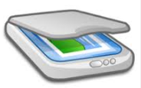
PriNt text – Conversion to Spoken Text
Letter in Mail
Take an Image
Convert Image to Text
Convert Text to Speech
Sometimes called “OCR” for Optical Character Recognition

Slide 6
Print text – Options for OCR
Mobile Device (phone/tablet)
Camera – receive image
Internet/OCR App – convert image to text
Internet/TTS App – convert text to speech
Computer
Scanner – receive/transmit image
Computer/OCR Software – convert image to text
Computer/TTS Software – convert text to speech

Slide 7
Print text – MOBILE DEVICE APPS
TextGrabber
iOS and Android
$4.99
Barebones
Scannable by Evernote
iOS and Android
$4.99
No TTS built in, need to use device TTS
KNFB Reader
Designed for blind access. K=Kurzweil, NFB = Natl Fed. Of Blind
iOS only
$99.99
Requires use of VoiceOver

Slide 8
Print text – MOBILE DEVICE DEMO
TextGrabber on iPad (also available for Android)

Slide 9
Print text – Computer applications
Read&Write Gold
Targeted s/w for mild cognitive impairment
Available for PC, Mac, Google
Robust tools for reading assistance
PC/Mac $465 on USB, Google $8.50/mo

Slide 10
Print text – Computer applications
Scrolled Text
Think of a marquee in Times Square
Can vary scroll rate
Can choose horizontal or vertical scroll
No TTS, intended for patients who want to “read”
Demo
Dream Scroller
Text Ticker

Slide 11
Types of Text and Conversion
Digital Text
For Profit – Kindle, Nook, iBook, E-Readers
Not For Profit – BARD, BookShare, Gutenberg
Hard-Copy Text
Computer/PC Tablet – Scanners, RWG, Scrollers
Mobile – Text Grabber, Scanable, KNFB Reader

Slide 12
Digital text
Digital Text Formats (aka, E-Text)
.txt – ASCII text (different flavors: ANSI, UTF, etc)
.pdf – Portable Document Format from Adobe
Epub – Open source, international standard
.azw or mobi – Proprietary, Amazon.com standard
DAISY – Digital Accessible Information System
.ibook – Proprietary, Apple standard

Slide 13
Digital text – For Profit E-Book Vendors
Option to buy proprietary reading device -or- download reading app to PC/Android/iOS.
Typically each book is sold individually at/near publisher price.
Amazon has a subscription service with access to a “library” of books…Kindle Unlimited ($9.99/mo)

Slide 14
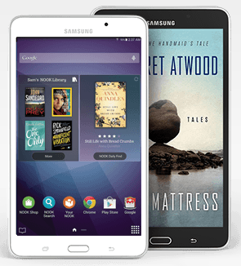
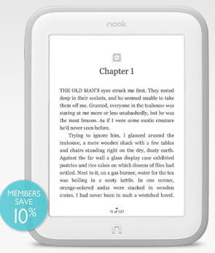
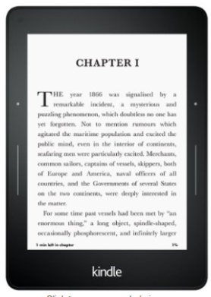
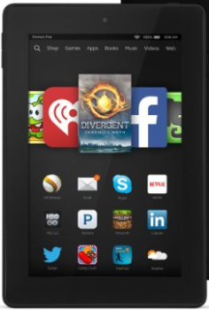
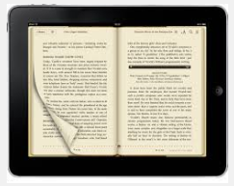
Digital text – For Profit E-book devices
Nook
Barnes & Noble
pure Android OS/tablet
PDF/EPUB
Kindle
Amazon
Modified Android OS
.azw/mobi/kf8/PDF/EPUB
iPad/iPod/iPhone
Apple
iOS
ibooks/PDF/EPUB

Slide 15
Digital text – For Profit E-book devices Access
Nook
Dedicated Nooks may offer text-to-speech
Android Nooks offer text-to-speech and switch access
Kindle
Most all Kindles offer text-to-speech
Switch access can be a problem
iPad/iPod/iPhone
iBooks app offers all access features of an iPad/iPod/iPhone
Full text-to-speech
Many “switch” access options

Slide 16
Digital text – NonProfit E-book Services
BARD – Braille and Audio Reading Download
Service of the National Library Service
Old Days used to ship brailled books to blind users
More recently, Books on Tape (now on USB)
No cost to user for player and books provided disability is documented
Books sent out by postal mail
BARD Mobile
Same as BARD, just online
Users can download books to USB or directly to a player with an app

Slide 17
Digital text – NonProfit E-book Services
BookShare.org
Grew out of K-12 education, now college and qualified users
Qualified users have visual impairment, reading disability, cognitive disability or physical disability which impacts ability to manipulate a book
Daisy files can be played on PC, Android, Apple devices
Cost $25 sign-up, $50/year
BARD is geared to listening; BookShare to reading/listening

Slide 18
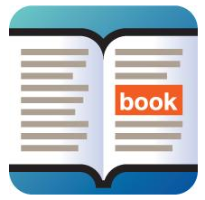
Digital text – NonProfit E-book Services
BookShare/Read2Go Demo on iPad

Slide 19
What do cases use?
Case #1 – Stroke with alexia
TextGrabber app
Case #2 – Mild TBI with dyslexia
Read & Write Gold for PC
BookShare
Case #3 – Degenerative, PSP
DreamScroller
BookShare

