Slide 1
Person Centered Thinking
An Introduction
Anne Roehl
Institute on Community Integration

Slide 2
Today’s Objectives
Learn the vocabulary and key concepts of Person-Centered Thinking and how it differs from Person Centered Planning
Understand the 3 levels of change and where we can help make change
Review Person-Centered Thinking skills
Learn about further training opportunities

Slide 3

What is “person centered”?
What does it mean to you?
What comes to your mind when you hear the words “person centered?”
What do you expect to see? Or not see?

Slide 4
BEING person centered
Being person centered
is different than DOING person centered
- It is BEYOND forms and checklists
- It includes how we treat each other

Slide 5
Person Centered Thinking is
BUILDING ON WHAT WE KNOW
AND HAVE DONE…AND IT
IMPACTS ORGANIZATIONS!
Notes:
It’s not just about you, but also about the system’s pull for system-centered thinking – it sucks us in!
We’re building on what we know/have/believe it…there’s nowhere to get to with Person Centeredness, there’s just always what’s next!

Slide 6
What is Person Centered Thinking?
A deliberate method to see the whole person, and not focus on “fixing what is wrong”
Set of tools that convey the core belief that all people have gifts to share
A set of skills that result in teams keeping the focus on the person who needs support – not agency or turf issues
A way to discover, describe and assure the desired life of the person who is supported
TLC-PCP 2012 www.learningcommunity.us

Slide 7
How is Person Centered Thinking different?
Powerful tools for discovery at level of the person
Focus on the “now”
“We need an increase not in person centered planning but in person-centered THINKING”
Tools for organizational and systems change
Notes:
Tools to do in a systematic way what we naturally know to do in our work: we don’t get into this industry without caring about people, but we don’t always get the results we want for people.
Systems barriers – story about Michael hearing the same stories over and over and realizing we need more PCT not more PCP workshops. PCT provides a specific skill set to make it happen for more people, which requires change for organizations and for our systems.

Slide 8
Why this approach in Minnesota?
It’s a method that:
Provides a “common language”
Promotes service planning and delivery that empowers people who receive services and their families
Enhances the state’s capacity improve the service system (allows us to SHAPE current and future changes)

Slide 9
The Basic Approach
Person Centered Thinking leads to
Person Centered Practices which lead to
Person Centered Organizations which create
Person Centered Systems that support
Person Directed Lives!

Slide 10
Our work is about –
Helping people get better lives
Not just better plans…
TLC-PCP 2012 www.learningcommunity.us

Slide 11
The Core Concept
Important To and Important For

Slide 12
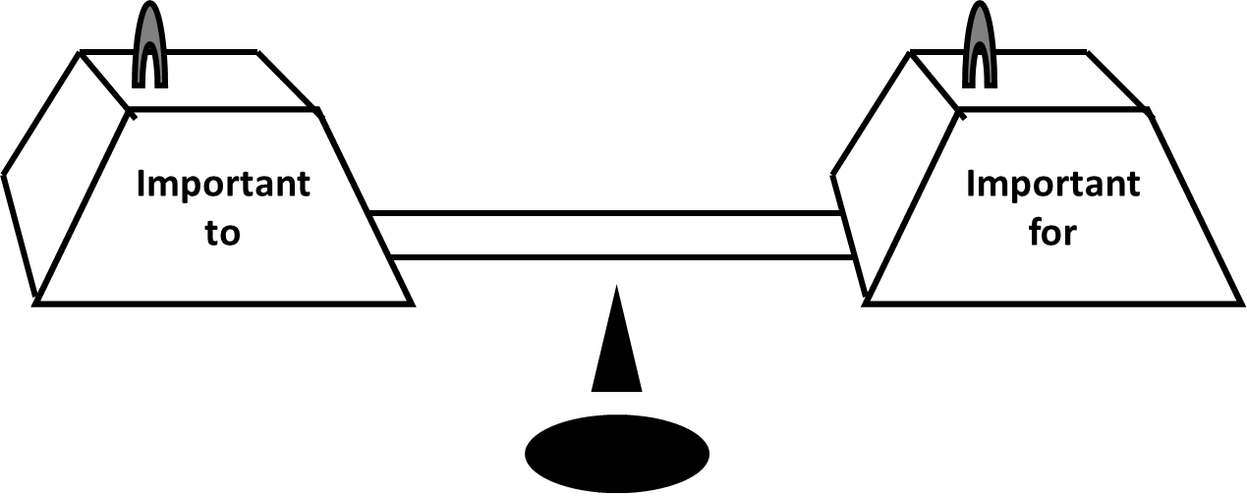
Core Concept
Important to and
Important for
TLC-PCP 2012 www.learningcommunity.us

Slide 13
Important To and Important For
What do we mean
Finding a balance between them
How they are connected
How you learn – the discovery process
TLC-PCP 2012 www.learningcommunity.us
Notes:
People attending the class should have been through PCT, so quickly review the next slides. Then give additional examples of things to consider:
Taking time to prepare for things
Being ready 15 minutes early
Sticking to a schedule
Spending time with friends
Being accepted, part of a group
A relationship with a specific person – sister, mother, father, etc. --- visiting with, talking to , having fun with, spending holidays with. Etc.
And simple things such as
Coffee whenever I want it
Pizza on the first Friday of every month
Going to the movies with friends on Saturday mornings.

Slide 14
Important to –
Those things in life which help us be satisfied, content, comforted and happy. It includes:
People to be with/relationships
Things to do/Places to go
Status and Control
Rituals or routines
Rhythm or pace of life
Things to have
TLC-PCP 2012 www.learningcommunity.us

Slide 15
Important to –
What is important to a person includes only what people are “saying”
  with their words
  with their behavior
When words and behavior are in conflict, listen to the behavior
TLC-PCP 2012 www.learningcommunity.us

Slide 16
Important to –
Includes what matters the most
to the person – their own
definition of quality of life
TLC-PCP 2012 www.learningcommunity.us

Slide 17
Important for –
This includes only those things that we need to keep in mind regarding:
Issues of health or safety
Physical health and safety, including wellness and prevention
Emotional health and safety, including support needed
2. What others see as important to help the person be a valued member of their community
TLC-PCP 2012 www.learningcommunity.us

Slide 18
Health and Safety
Dictate Lifestyle
Important
to
Important
for
TLC-PCP 2012 www.learningcommunity.us

Slide 19
All Choice
No Responsibility
Important
to
Important
for
TLC-PCP 2012 www.learningcommunity.us
Notes:
Address: 245D is not “let people do whatever they want!)

Slide 20
Balance
Important
to
Important
for
TLC-PCP 2012 www.learningcommunity.us

Slide 21
Finding a Balance
If something is important for us and is also important to us, we will do it
If something important for us is not important to us, we have no interest in doing it
If we want people to attend to what is important for there has to be an aspect of it that is important to
TLC-PCP 2012 www.learningcommunity.us

Slide 22
Balancing Important TO and FOR
Sequence matters: learning about what matters the most to the person first (a critical aspect)
It is not about either/or: paying attention to health, safety and valued social roles is critical, but alone it is insufficient if not in the context of “important TO”
TLC-PCP 2012 www.learningcommunity.us

Slide 23
Balancing Important TO and FOR
Risk management techniques currently often focus on assuring safety or health at the cost of what creates satisfaction for the person
We need to change our frame of reference to believe that both can co-exist
TLC-PCP 2012 www.learningcommunity.us

Slide 24
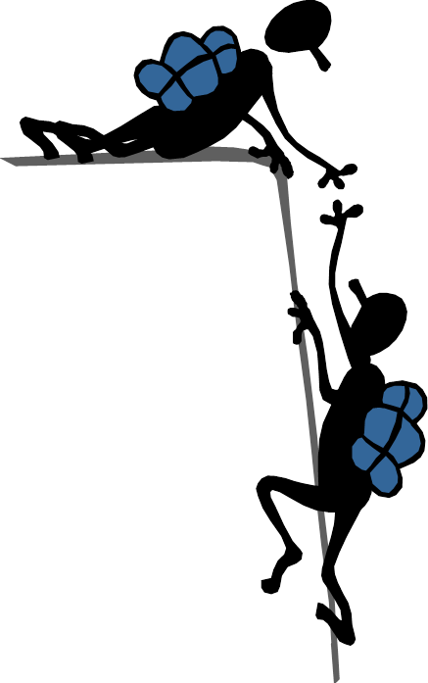
A good balance
…means supporting,
not fixing!

Slide 25
Learning about Support
Power Over
Power With
Fixing vs. Supporting
Wrkbk pg 42
Notes:
TLC-PCP www.learningcommunity.us

Slide 26
What you see/hear depends on what you are looking/listening for
Look/Listen
Understand

Slide 27
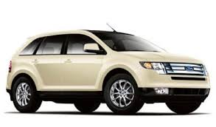
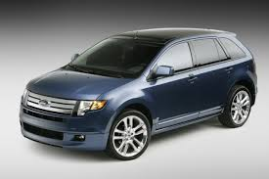
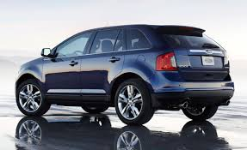
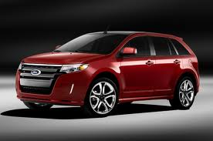
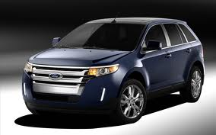

What’s a Ford Edge?
Notes:
ANIMATED: Betsy’s story – husband suggested a ford edge. She’d never heard of or seen one, until the next times he was on the road and they just kept appearing.

Slide 28
Person Centered Tools
Help us to
  Support people vs. fix them
  Get out of the trap of seeing only what we’re looking for
  Help people to define and pursue meaningful experiences: Community LIFE vs. PRESENCE

Slide 29
Our work is about –
Helping people get better lives
Not just better plans…
TLC-PCP 2012 www.learningcommunity.us

Slide 30
Person Centered Outcomes

Slide 31
3 Levels of Change
Any changes that results in a positive difference in the lives of people who use services or in your own work life.
Level 1
Any changes an organization makes to its practices, structure or rules that result in positive differences in the lives of people.
Level 2
Any change in practice, structure and rules made at the system level. These changes have an effect on many organizations, and therefore many peoples’ lives.
Level 3
TLC-PCP 2012 www.learningcommunity.us

Slide 32
Levels of Change - Discussion
Some Examples of Level 1 Changes
  Language
  Menu Planning
  Morning Routines
Share Examples of Level 1 Changes
you’ve made or could make

Slide 33

Where do you start?
How do you know what to change for people?
Person Centered Tools help us to listen for the answer!

Slide 34
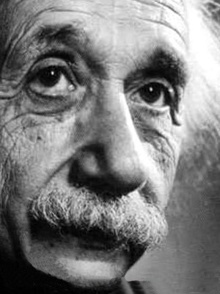
If I had an hour to save the world, I’d spend 55 minutes defining the problem.
-Albert Einstein
Ask yourself “What do we know?”
Before asking “What do we do?”
Notes:
But we are TERRIBLE at listening…the tools help us to SLOW DOWN and listen to people with fresh ears

Slide 35
Defining the problem
The more time you spend
understanding the situation…
the better the solutions

Slide 36
Some tools to help with this
Person Centered Thinking Tools

Slide 37

Good Day
Bad Day
Relationship
Map
Routines &
Rituals
Donut
Matching
Management Tools
2-Minute Drill
Reputation
Learning Logs
Communication
Working
Not Working
Important To Important For & The Balance Between
Discovery/
Listening Tools
4 + 1 ?s
Everyday Learning Tools
Notes:
The tools can be divided into 3 categories:
Discovery/Listening: About gathering information we might otherwise miss
Everyday Learning: These tools help us learn about and address the daily issues/concerns we encounter.
Management: These tools help to clarify roles and to use strengths/interests to provide a good match between the work and the people doing the work

Slide 38
Discovery/Learning Tools
Relationship Maps
Rituals and Routines
2 minute drill
Communication Chart
Reputations
Good Day/Bad Day
Notes:
Provide general overview of each tool/purpose…GD/BD last to cover, example given

Slide 39
Simple Conversations
Good Day
Bad Day
What happened that contributed to your good day?
What do you look forward to doing?
Who do you look forward to seeing?
What happens that gives you energy to deal with difficult situations?
What motivates and interests you at work OR on a work day?
What threw your day off?
Made the day bad for you?
Made you frustrated? Bored?
Took the fun out of it?
Be sure to include those daily frustrations
TLC-PCP 2012 www.learningcommunity.us
Notes:
Many of our tools are SIMPLE CONVERSATIONS that can lead to profound insights about people.
They help us dig deeper and understand what’s under the surface, what really matters to people.
TLC-PCP www.learningcommunity.us

Slide 40
Anne’s Good Day/Bad Day
Good Day
Bad Day
Smooth morning routine for my kids
Less traffic than expected!
Full Schedule
Meetings start on time, stay on task
Trainers are on time and prepared to go…technologically & personally
Supplies are prepared in advance
I remembered my lunch and have a green smoothie
Training & it makes a difference: people get a lot out of it and see how they can use the skills
Creating new trainings
No sleep the night before and/or my son has a hard morning
Doing data entry/LONG meetings
Technology doesn’t work
Home late, lots of “after hours” work or lots of driving after long day of training
I’ve forgotten something critical to an event, meeting or for myself
I have an “off day” and struggle to explain exercises clearly or deliver training in an engaging way
Emergency requests for information when I’m training

Slide 41
Sorting: Example
What is important TO me?
Good Day Bad Day___
Trainers are on time and prepared
People see how they can use the skills
Data Entry;
Long Meetings
After hours work or lots of driving
Making a meaningful impact
Being Efficient – spending time with family at night, not working!

Slide 42
Sorting: Example
What can others do to SUPPORT me?
Good Day Bad Day___
Help manage logistics and keep things organized
Stay on time; keep meetings purposeful and short
Trainers are on time and prepared
People see how they can use the skills
Data Entry;
Long Meetings
After hours work or lots of driving

Slide 43
Management Tools
Donut – clarification of roles
Matching – staff skills to activities

Slide 44
Everyday Learning Tools
Learning Logs
Working/Not working (a.k.a. Makes Sense/Doesn’t Make Sense)
4 + 1 Questions
TLC-PCP 2012 www.learningcommunity.us

Slide 45
Organizing Discovery Information
Two formats to organize what we learn with Person-Centered Thinking:
  A Person Centered Description
  A One Page Profile

Slide 46
A Person Centered Description:
Creates a positive picture of who the person is and how to best support (including any challenges).
Establishes a shared understanding of good support between person, family and providers.
Informs action planning
Helps us to recruit and select providers/staff who are well matched
A person centered description may be several pages long
Wrkbk pg 44
Notes:
TLC-PCP www.learningcommunity.us

Slide 47
One Page Profiles
For a specific purpose: for example new situations- like a new job or supervisor; meeting new people; at the front of the person’s records.
An “at a glance” positive way to share key information about:
    What people like and admire
    What is most important to
    How to best support
TLC-PCP 2012 www.learningcommunity.us

Slide 48
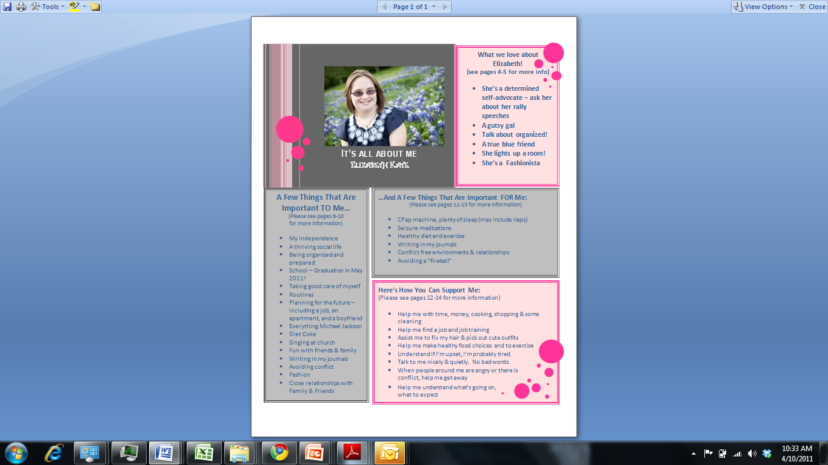
Notes:
TLC-PCP www.learningcommunity.us

Slide 50
Notes:
Example of USE OF TOOLS IN AN ORGANIZATION/BUSINESS

Slide 51
One Page Profile: The Team
Everyday Learning can build consensus about what’s important to and for the team
Teams can also create profiles to
  Express what is discovered about important to
  Keep present what is learned
  Share culture with new members of the team
Notes:
Example of USE OF TOOLS IN AN ORGANIZATION/BUSINESS

Slide 52
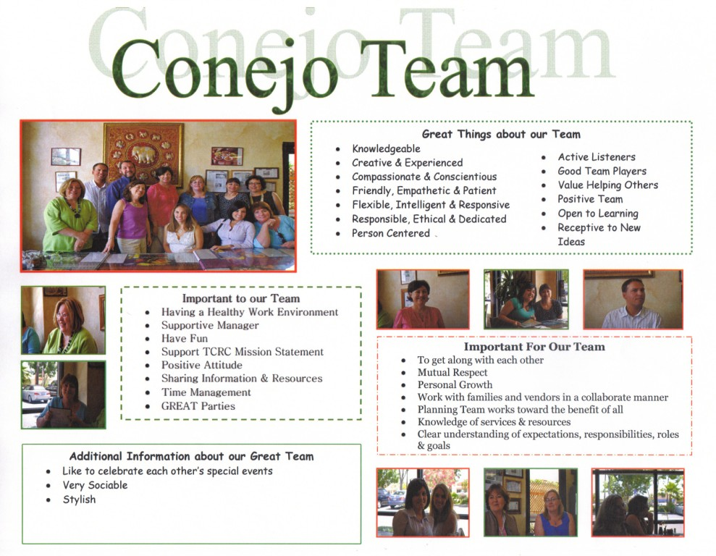
Examples – Page 22
© TLC-PCP 2012 www.learningcommunity.us

Slide 53
Quality Person Centered Planning
There is no “right planning method” for all people and all situations. A quality plan is:
a promise to listen
a promise to act on what is heard
a promise to be honest
a promise to KEEP discovering and honoring what’s important to people.
TLC-PCP 2012 www.learningcommunity.us

Slide 54
Training Opportunities
Person Centered Thinking
is a 2-day, interactive training
Learning and exposure to the tools
Practice using tools

Slide 55
Easy Online Registration
Sign up or request to be notified of future dates :
rtc.umn.edu/pctp/training/

Slide 56
Other Training Opportunities
1. 2-Day Person-Centered Thinking
2. 2-Day Person-Centered Planning

Slide 57
This Person Centered Planning Format
“Picture of a Life”
Is aimed at creating a life change (pursuing a move, new job, etc), asking:
  Who is the person?
  What should each area of life look like?
  What support will the person need?
Is done with a co-trainer, who is someone that uses services

Slide 58
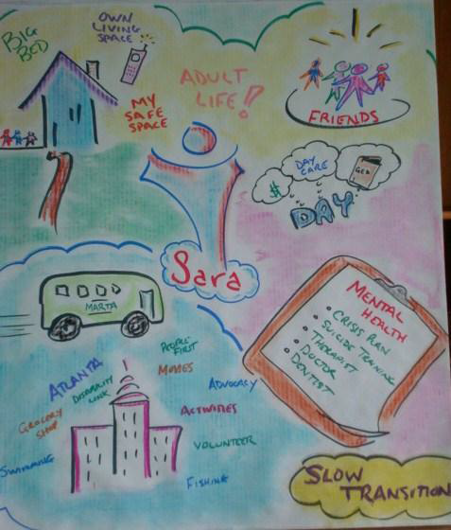
A Picture
of a Life:
Visual
Sparks creativity
Includes a written description

Slide 59
Easy Online Registration
Sign up or request to be notified of future dates :
rtc.umn.edu/pctp/training/

Slide 60
Other Training Opportunities
1. 2-Day Person-Centered Thinking
2. 2-Day Person-Centered Planning
3. Organizational Change
Coaches and Leaders training/
Technical assistance for agency change

Slide 61

1. 2-Day Person-Centered Thinking
2. 2-Day Person-Centered Planning
3. Organizational Change
Coaches and Leaders training
Technical assistance for agency change
4. DirectCourse – online learning lessons

Slide 62

Train Anytime!
Online training
College of Direct Support, Frontline Supervision, Employment and much more!
Meet 245 D requirements with online training
Contact Nancy McCulloh for details
 320-253-5661  mccul037@umn.edu

Slide 63
Thank You!
If you want to know more about us or our trainings, feel free to contact me!
Anne Roehl
Research and Training Center on Community Living
Institute on Community Integration
University of Minnesota
612-310-4661 or vand0202@umn.edu
PCT Registration : http://rtc.umn.edu/pctp/training/

